Slide 1
What is Psychology?
An amazing PowerPoint Chapter 1:

Slide 2
Read “A Day in the Life”, page 3
Consider the following:

Slide 3
Section 1 – Why study psychology?
Psychology: the scientific study of behavior and mental processes
Behavior: Any action that other people can observe or measure
Can be observed by another person (walking)
Can be measured through scientific instruments (body functions such as heart rate; brain activity)

Slide 4
What are cognitive activities?
Cognitive activity: Private, unobservable mental processes such as sensation, perception, thought, problem solving

Slide 5
What are psychological constructs?
Psychological constructs – Concepts that enable us to discuss something that cannot be seen, touched, or measured directly

Slide 6
Goals of Psychology
Observe and describe behavior and mental processes in order to better understand them

Slide 7
Theories, Principles
Theory: Statement that attempts to explain why things are the way they are and happen the way they do
*Often disproven and revised*
Principle: a rule or law

Slide 8
based on scientific research and empirical evidence – from observation, experimentation, or measurement

Slide 9
Psychology’s Past
Until the 1800s, psychology was not a formal discipline

Slide 10
Roots from Ancient Greece
More than 2000 years ago, Ancient Greece:
Socrates, “Know thyself”
-Introspection: Look within
Aristotle- Associationism: Connecting new experiences to previously learned experiences
Ancient Greeks associated erratic, confused behaviors as the gods punishing people
Hippocrates suggested such problems were from abnormalities in brain

Slide 11
The Middle Ages
During Middle Ages, most Europeans believed problems such as agitation and confusion were signs of possession by demon
Test: Throw person into deep water; if they are pure, they will sink; if they are impure they will float and must die *not 100% accurate

Slide 12
Birth of Modern Science
1500s-1700s: Scientific revolution ; scientific method;
This approach led to the birth of modern psychology in 1879

Slide 13
Psychology’s Past
Wanted to describe, predict, understand, and modify behavior
They did not rely on empirical evidence – observations were often based on anecdotes or descriptions

Slide 14
Psychology’s Past – Good News, Bad News
Good News – early thinkers not always wrong
Ex.: Hippocrates – brain is the source of all pleasures

Slide 15
Psychology’s Past – Good News, Bad News
Bad News – without empirical methods, mistakes were made
Phrenology: Different brain areas accounted for specific character and personality traits
Graphology: One’s personality could be revealed through handwriting
Astrology: Heavenly bodies influence human affairs

Slide 16
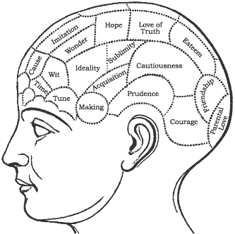
Phrenology

Slide 17
Graphology

Slide 18
Astrology

Slide 19
Psychology’s Past
Three early psychologies
Structuralism
Functionalism
Psychoanalysis

Slide 20
Birth of Modern Psychology
1879 – First psychological laboratory – Wilhelm Wundt (Germany) – first person to announce that he intended to make psychology a science
His field became known as structuralism
Structuralism: Breaks down experiences into objective sensations and subjective feelings
Objective: Apple is round, red
Subjective: Apple tastes good; makes me happy
This is very basic; difficult to measure

Slide 21
Functionalism
William James
interested in how and why things happen
Functionalism: how do mental processes help organisms adapt to their environment? (What is their function?)
Adaptive behaviors (successful) are repeated and become habits; Less adaptive behaviors are dropped *Concentrated on mental processes, hard to measure (psychological constructs)

Slide 23
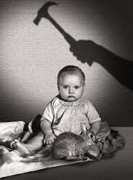
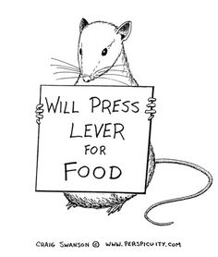
Behaviorism, John Watson
Watson agreed with functionalism, wanted something more measureable
Behaviorism: Study of observable behavior (Little Albert Study)
B.F. Skinner agreed; he added the idea of ‘reinforcement’ to promote certain behaviors (tested on pigeons, rats)

Slide 24
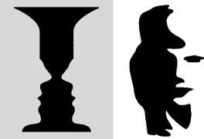
Gestalt School
Gestalt Psychology – school of thought that questioned how people interpret information
They believe that perception is important and observable behaviors alone are not enough

Slide 25
Psychoanalysis
A theory of personality and a method of psychotherapy, originally formulated by Sigmund Freud.
Emphasizes unconscious motives and conflicts that occur during early childhood and were too threatening to remember consciously
Freud argued that conscious awareness is merely the tip of the iceberg – the unconscious mind beneath the tip

Slide 26
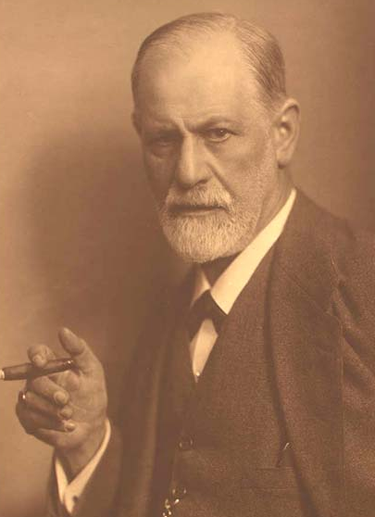
Psychoanalysis
Freud concluded that the unconscious mind contained unrevealed wishes, passions, guilty secrets, unspeakable yearnings, and conflicts between desire and duty
Many of these urges and thoughts are sexual or aggressive in nature

Slide 28
Major Psychological Perspectives
Biological Perspective
Learning Perspective
Cognitive Perspective
Sociocultural perspective
Psychodynamic Perspective

Slide 29
The Biological Perspective
emphasizes bodily events and changes associated with actions, feelings and thoughts – how biology affects learning and performance, perceptions of reality, emotion
This perspective involves:
Hormones
Brain chemistry
Heredity
Evolutionary influences

Slide 30
The Learning Perspective
emphasizes how the environment and experience affect a person’s or animal’s actions
This perspective involves
Behaviorism
Social-cognitive learning
theories

Slide 31
The Cognitive Perspective
emphasizes mental processes in perception, memory, language, problem solving and other areas of behavior.
This perspective involves
Computer models of human thinking
Infant thinking
Intelligence testing.

Slide 32
Sociocultural Perspective
emphasizes social and cultural influences on behavior
This perspective includes:
the study of rules, roles, groups and relationships.
the study of cultural norms, values and expectations.

Slide 33
Psychodynamic Perspective
emphasizes unconscious dynamics within the individual, such as inner forces, conflicts or the movement of instinctual energy.
This perspective includes:
Unconscious thoughts, desires, conflicts.

Slide 34
Other Influential Movements In Psychology
Humanist Psychology – emphasized personal growth and potential
Feminist Psychology - analyzed the influence of social inequities on gender relations and on behavior of the two sexes

Slide 35
What do Psychologists do?
Academic/Research Psychologists
Clinical Psychologists
Psychologists in Industry, Law, and other settings

Slide 36
Academic/Research Psychologists
Research in areas of basic or applied psychology.
Examples include:
Experimental psychologists
Educational psychologists
Developmental psychologists
Industrial/Organizational psychologists
Psychometric psychologists

Slide 37
Psychological Practitioners
Counseling psychologists help people deal with problems associated with everyday life.
School psychologists work with parents, teachers and students to enhance student performance.
Clinical psychologists diagnose, treat, and study mental or emotional problems.

Slide 38
Clinical Psychologists are not:
Psychotherapists
Anyone who does any type of psychotherapy.
Psychoanalysts
Individuals who receive training in psychoanalysis.
Psychiatrists
Medical doctors who diagnose and treat mental disorders.

Slide 39
Psychologists in Other Settings
Sports
Consumer Issues
Advertising
Organizational Problems
Environmental Issues
Public policy
Opinion polls
Military training
Animal behavior
Legal Issues

Slide 40
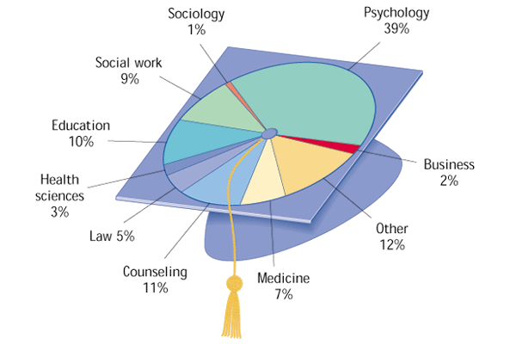
What Areas do Psychology Undergraduates Pursue?
Psychology
Other
Counseling
Education
Social work
Medicine
Law
Health Sciences
Business
Sociology

