Slide 1
The Legislative Branch
Congress

Slide 2
Part One: The Organization of Congress
Section One: Congressional Membership
Section Two: The House of Representatives
Section Three: The Senate
Section Four: Congressional Committees

Slide 3
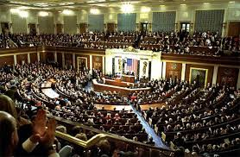
Congressional Membership
The Founding Fathers intended to make the legislative branch slightly more powerful than the other two branches
This branch is created through Article One of the Constitution
The U.S. legislative branch is known as ‘Congress’
Congress works at the U.S. Capitol, and is a bicameral legislature
Bicameral = made up of two houses (Senate and House of Representatives)
Congress plays a central role in formulating (creating) national laws and policies

Slide 4
Congressional Sessions
Terms of Congress begin on Jan. 3rd every odd numbered year, and last for two years.
Each term includes two sessions (each session lasts one year)

Slide 5
Membership of the House of Representatives
Today, there are 435 members
Membership per state is based off population (states with larger population get more representatives)
Each state must have at least one seat in the House
This is the ‘Lower House’ of Congress
Qualifications for being elected to House of Representatives:
Category | Requirement
Citizenship | U.S. citizen for at least 7 years
Residency | Legal resident of state you represent
AGE | 25 Years old
Term length | Two year terms
Represent | Their district in the state

Slide 6
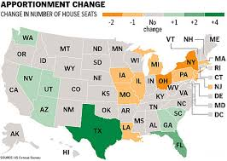
House of Representatives: Representation and Reapportionment
Every ten years, a census is taken to determine how many representatives each state should get; because its taken every ten years, the number of representatives per state stays the same for a ten year period
Census: A population count (the next one will take place in 2020)
After the census comes reapportionment—This is the process of reassigning representation based on population, after every census (states where population decreased will lose representatives; states where population increased will gain representatives)
What state gained the most seats during reapportionment?
What state lost the most?
What does this tell you about the population of those states in the last ten years?

Slide 7
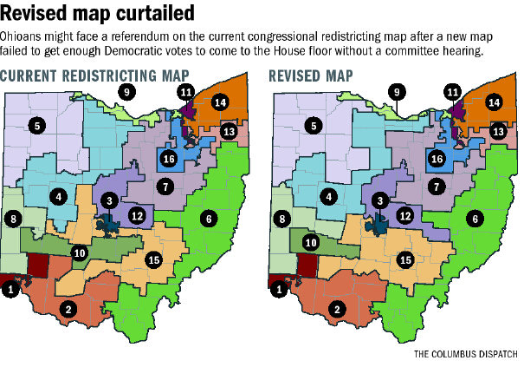
House of Representatives: Congressional Redistricting
After states find out how many representatives they get, they draw the lines for the Congressional district in that state
One representative serves each district
The process of redrawing district lines is known as ‘redistricting’
This must be done, because the number of representatives changes
Look at the map -- which districts look the same?
Which look different?

Slide 8
House of Representatives: Gerrymanding (Jerry-mandering)
In order to take advantage of a state’s ability to re-district, Gerrymandering often takes place.
Gerrymandering is redrawing district boundaries to give one party an advantage
It is seen when strangely shaped districts that either: “Packing” most voters of the opposing party into one district (so that all the other districts will vote for the party doing the gerrymandering), or ‘Cracking”, meaning dividing the opposing party’s voters into several districts

Slide 9
The Senate
100 Members
Two from each of the 50 states
This is the ‘Upper House’ of Congress
Category | Requirement
Citizenship | U.S. citizen for at least 9 years
Residency | Legal resident of state you represent
AGE | 30 Years old
Term length | Six Year Terms
Represent | Entire State (They do not have districts)

Slide 10
Senate and House: Salary and Benefits
In 1789, the Senate and House each made $6 per day! This kept many from wanting to join
Between $170,000-$230,700/year
$150,000 or more per year for life after they retire
Franking Privilege (stationary and postage for official business); health care; gymnasium; large allowances for trips home, to pay staff, telephones; large income tax deduction

Slide 11
The Members of Congress
Nearly half of the members of Congress are lawyers
Most are incumbents—members who were already in office and won reelection.

Slide 12
Part Two: House of Representatives
In this House, much of the work is done in committees (more than the Senate)
Representatives tend to specialize more on a few issues that apply to their constituents (the people of their district)
Members often serve on committees that are important to their constituents (a member from a farming district would serve on an agriculture committee)
In the House of Representatives, Republicans sit on the right side of the chamber; democrats on the left

Slide 13
House Leadership
Leaders in the House work towards six goals:
-Organize and unify party members
-Schedule work
-Make certain that lawmakers are present for key floor votes
-Distribute and collect information
-Keep the House in touch with the President
-Influence lawmakers to support their party’s decisions

Slide 14
Speaker of the House
Speaker of the House is the presiding officer in the House of Representatives
Chosen through a caucus, or closed meeting, of the majority party
The Speaker of the House is third in line for Presidency (after Vice President)
The Speaker of the House: -Appoints the members of some committees
-Schedules bills for action
-Refers bills to the proper committee

Slide 15
Lawmaking in the House
All laws start as bills; they are bills until both houses of Congress pass them, and the President signs them
To introduce a bill into the House of Representatives—
-Representatives drop it into a hopper, a box near the front of the chamber
-After it is introduced, the Speaker of the House sends it to the proper committee for discussion, review
Only about 10 to 20 percent actually make it through this process
-Bills that survive the committee process are then put on the House Calendar to be debated
A quorum is the minimum number of members needed for official legislative action

Slide 16
Part Three: The Senate
-The Senate usually have unlimited debate (the House is limited)
-The Vice President presides over the Senate, but has no vote, except to break a tie
When the Vice President is not there (which is often the case), the President Pro Tempore presides. This person is elected by the Senate from the Majority party. Usually the party’s longest serving member
Majority and Minority leaders work to keep their parties united, and to sway votes in favor of their party

Slide 17
How Senate Bills are Introduced
Because it is smaller than the House of Representatives, it is less formal
They bring bills to the floor by unanimous consent

Slide 18
Senate: The Filibuster
Because the Senate has unlimited debate, Senators often use a filibuster to fight against it.
A filibuster means to extend the debate to prevent a bill from becoming a vote.
Example: In the 1930s, Senator Huey Long recited Shakespeare, with the intent of making other Senators so tired of hearing him, that they don’t pass the bill! Another Senator once read a phone book as he tried to filibuster a bill
Cloture is the only thing that can stop a filibuster. This limits a Senator to only one hour of speaking about a bill; however, to get cloture, 60 of the 100 Senators must vote for it.

Slide 19
Part Four: Congressional Committees
Know:
Standing Committees
Select Committees
Joint Committees
Conference Committees

Slide 20
Part Four: Congressional Committees
Both the House and the Senate depend on committees to consider the thousands of bills that come up each session
In committees, lawmakers can become specialists on the issues that their committees consider
Committees select the few bills that are to receive further consideration
Most bills do not make it past this stage

Slide 21
Committees, continued
Committees become experts on certain issues through investigations, and listening to supporters and opponents

Slide 22
Types of Committees
Standing Committees
Select Committees
Joint Committees
Conference Committees

Slide 23
Standing Committees
The permanent committees that stand from one session of Congress to the next
Examples from in the House:
Agriculture Armed Services Budget Education/Labor Energy/Commerce Financial Services Homeland Security Foreign Affairs
The permanent committees that stand from one session of Congress to the next
Examples from in the Senate:
Agriculture Armed Services Banking, Housing, Urban Affairs Budget Commerce, Science Education/Labor Energy and Natural Resources Judiciary Homeland Security Foreign Relations
Do some of these overlap???

Slide 24
Select Committees
Select Committees are temporary committees that study one specific issue and report their findings to the Senate or the House (such as a gasoline problem, or a problem that has been neglected for a while)
These are meant to last no more than one term of Congress

Slide 25
Joint Committees
Joint committees are made up of members from both the Senate and the House and can be temporary or permanent.

Slide 26
Conference Committee
A conference committee is a temporary committee that is set up when the House and Senate have passed different versions of the same bill.
The job of the conference committee is to resolve the differences between the two bills and pass an acceptable one for the President to sign.

