Slide 1
Roles of President

Slide 2
Objective: Students will be able to: - Identify and define the roles and formal and informal powers of the President.
Drill:
Which propaganda technique is this an example of?
Band-wagon
Testimonial
Glittery Generalities
Name-calling
2. What impact do you think media has on elections?

Slide 3
Roles of the President
Chief Legislator
Commander-in-Chief
Foreign Policy Leader (Chief Diplomat)
Chief Executive

Slide 4
ROLES AND POWERS OF THE PRESIDENT
CHIEF OF STATE *attends ceremonies *represents head of U.S *gives speeches
CHIEF EXECUTIVE *head of executive departments and agencies *enforces national policy
*appoints justices/judges and cabinet heads *carries out laws
CHIEF DIPLOMAT *directs foreign policy *negotiates treaties
CHIEF LEGISLATURE *suggests new laws he/she wants passed * approves or vetoes bills passed by Congress
CHIEF OF ECONOMY *plans nation’s economy policy *proposes budget for federal government
COMMANDER-IN-CHIEF *directs/controls the nation’s armed forces *uses military to keep order
CHIEF OF POLITICAL PARTY *leader of his/her political party *helps with campaigning and fundraising

Slide 5
CHIEF OF STATE
Represent nation
Hosts other heads of government
Performs ceremonial roles
Gives and awards medals
Meets with public figures

Slide 6
CHIEF EXECUTIVE
Carries out laws
Makes executive orders
Appoints cabinet members
Removes appointed officials
Grants reprieves
Grants pardons
Grants amnesty

Slide 7
CHIEF LEGISLATOR
Delivers State of the Union Address
Works with staff to write legislation
Veto power
Sign legislation
Influences domestic policy
Presents budget to Congress

Slide 8
ECONOMIC PLANNER
Submits annual economic report to Congress
Council of Economic Advisors
Prepares yearly federal budget

Slide 9
PARTY LEADER
Gives speeches for party
Attends fundraising events
Select’s party’s national chairperson
Helps plan election strategy
Appoints party members to government jobs

Slide 10
CHIEF DIPLOMAT
Directs foreign policy
Works with CIA and NSA
Negotiates and signs treaties
Makes executive agreements
Recognize foreign governments

Slide 11
COMMANDER IN CHIEF
Power to make war
Makes key military decisions
Authority to use atomic weapons
Uses military to control disorders in our country
Supports war effort at home

Slide 12
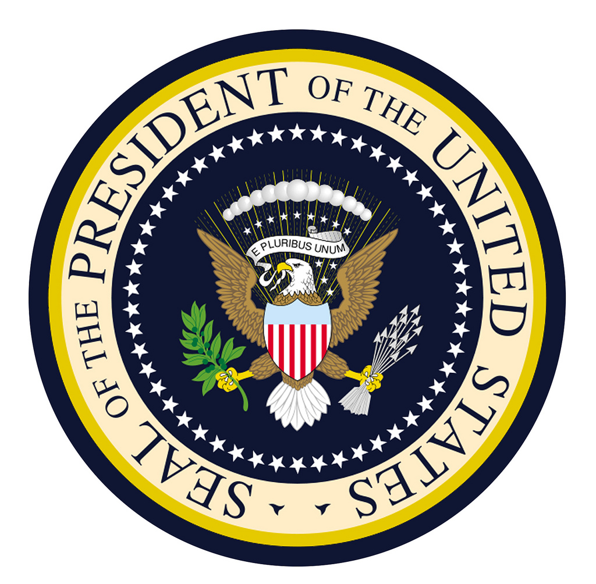
WHICH PRESIDENTIAL ROLE IS IT?

Slide 13
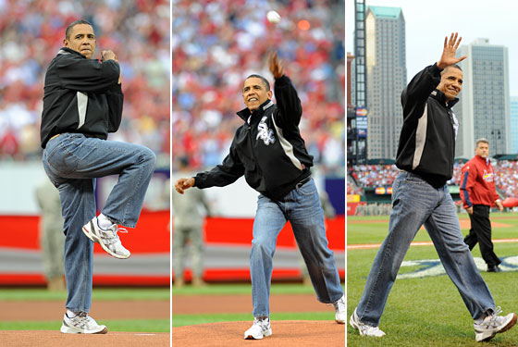
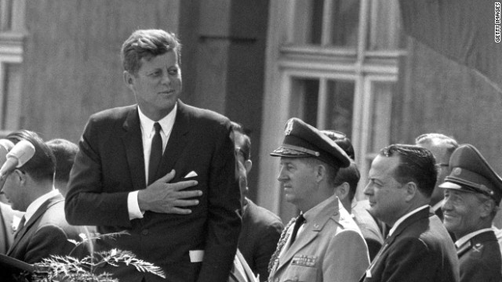
President Kennedy speaks at Berlin Wall, 1963
President Obama throwing the First Pitch at the World Series

Slide 14
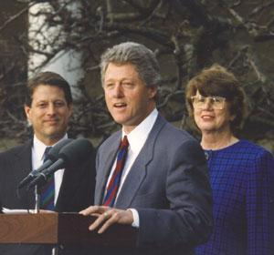
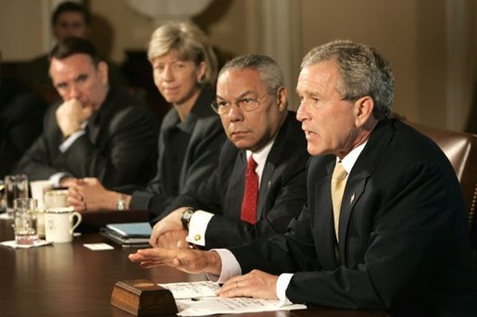
President Clinton with Janet Reno, the first female Attorney General
February, 1933
President Bush holds cabinet meeting in October, 2005

Slide 15
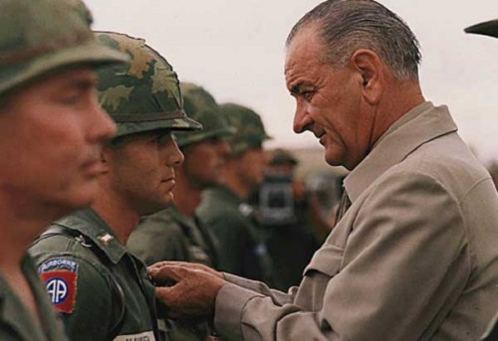
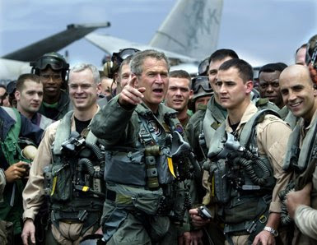
President Johnson decorates a soldier in Vietnam
October, 1966
President Bush aboard U.S.S. Lincoln
May, 2003

Slide 16
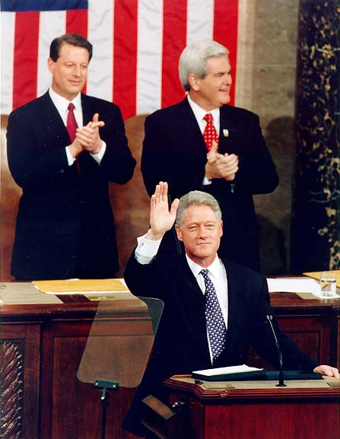
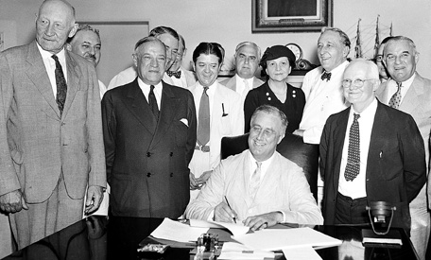
President Roosevelt signs into law the National Security Act
1935
President Clinton delivers the State of the Union Address
1997

Slide 17
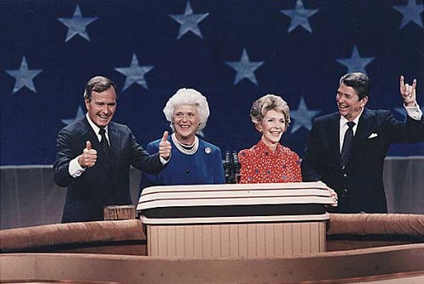
President Reagan and Vice-President Bush accepting their party’s nomination
1980

Slide 18
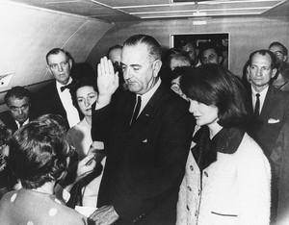
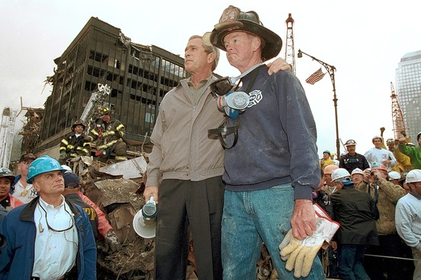
Vice-President Johnson sworn in aboard the Air Force-One after President Kennedy’s assassination
1963
President Bush at Ground Zero after 9-11

Slide 19
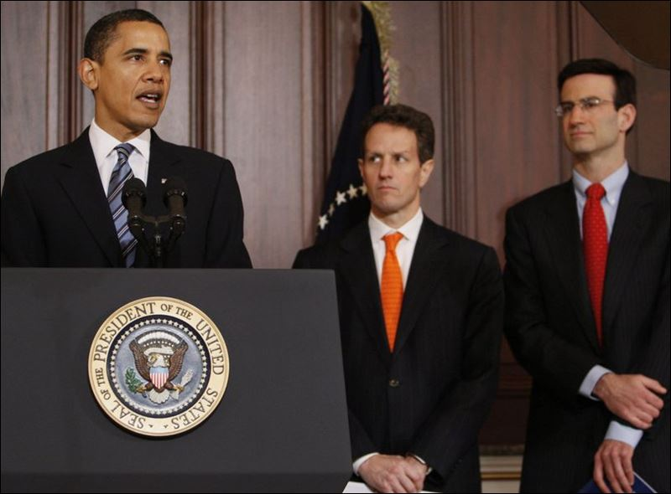
President Obama, accompanied by Budget Director Peter Orszag

Slide 20
Executive Orders
An order issued by the President that carry the force of law
-Who usually does this: Congress
Examples:
Clinton’s “Don’t ask don’t tell” gays in the military policy
FDR’s internment of Japanese Americans

Slide 21
Executive Agreements
An international agreement made by a president that has the force of a treaty; does NOT need Senate approval (usually deals with trade)
-Who usually does this: Senate
Examples:
Jefferson’s purchase of Louisiana in 1803
1994- North American Free Trade Agreement

Slide 22
Executive Privilege
Claim by a President that he has the right to decide that the national interest will be better served if certain information is withheld from the public, including the Courts and Congress
United States v. Nixon (1973) – Presidents do NOT have unqualified executive privilege (Nixon Watergate tapes)

Slide 23
Roles of the President
Meets with the British Prime Minister to discuss plans on Iraq.
Hands down and order to all generals to begin pulling back troops from the battlefield.
Appoints a new Secretary of the Treasury.
Proposes a bill to Congress to make all schools adopt a uniform system.
Meets with members of his party to discuss campaign strategies for the next election.

Slide 24
Roles of the President cont.
Speaks at a college graduation to inspire a new group of graduates.
Proposes a federal tax cut to stimulate the flow of money.
Meets with the Vice President to assign him new responsibilities on education reform.
Meets with members of the Senate to discuss a new plan to intensify tobacco laws.
An announced honorary captain for the Thanksgiving Day game between the Lions and Bears.

Slide 25
Roles of the President cont.
Signs off to deploy 5,000 more troops into Afghanistan.
Shows up to speak and endorse a candidate for Governor of Delaware that shares his same political party.
Sits down with leaders of the new Iraqi government to discuss plans for moving forward with Iraq’s new democracy.
Decides that 60% of the federal money will go towards funding defense.

