Slide 1
Unit 2, Part 1: Industrialization and Immigration (Sections 1 & 2)
Section 1: A Technological Revolution
Section 2: Advances in Railroad

Slide 2
Section One
A Technological Revolution

Slide 3
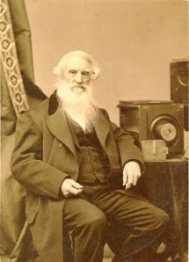
I. Origins of the Industrial Revolution
Samuel Morse sends the first electromagnetic telegraph (1844)
1. From Washington D.C. to Baltimore
2. “What hath God wrought”
Notes:
Morse invented Morse code and the first message sent by this means traveled from Washington to Baltimore In 1844. The message read 'What hath God wrought'. Morse code is a digital signal usually like a wave. It can be transmitted by light, radio waves or sound

Slide 4
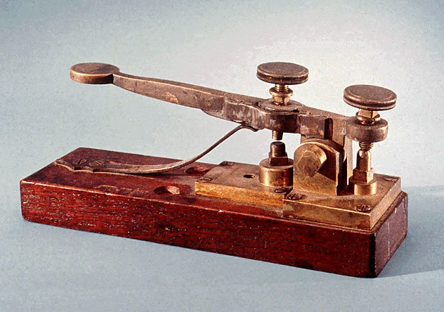
B. After the Civil War (1865) Americans are able to focus their energy on improving their lives
1. Record number of patents are issued
2. A time of vast productivity in our country
Notes:
A patent is a form of intellectual property that gives its owner the legal right to exclude others from making, using, selling, and importing an invention for a limited period of years, in exchange for publishing an enabling public disclosure of the invention.
Copyright, a form of intellectual property law, protects original works of authorship including literary, dramatic, musical, and artistic works, such as poetry, novels, movies, songs, computer software, and architecture.
A trademark is a symbol, word, or words legally registered or established by use as representing a company or product.

Slide 5
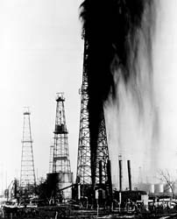
II. New forms of energy
Edwin Drake becomes the first to drill for oil
1. Titusville, Penn. (1858)
2. A new source of energy is discovered
Notes:
Though he drilled only three oil wells in his lifetime, Edwin Drake (1819-1880) is known as the "Father of the Petroleum Industry" because the technology he devised to drill the first commercial oil well in the United States revolutionized how crude oil was produced and launched the large-scale petroleum industry.

Slide 6
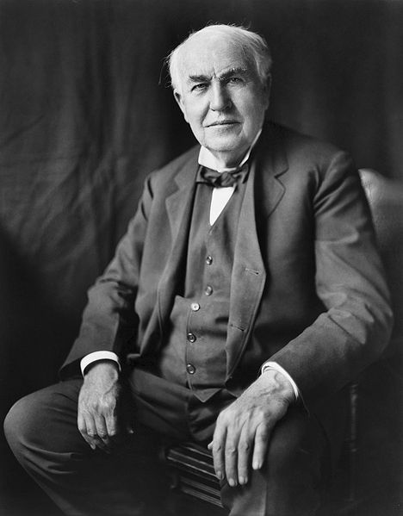
B. Thomas Edison harnesses energy
1. Invention of the electric light bulb
2. Creation of central power stations
Video: The History of Thomas Edison
Notes:
Edison's first great invention was the phonograph in 1877 although he didn't bring to the public until 1887 because he was busy working on his greatest invention, electric light. Edison installed the first electric lights in his own lab and the first public power system in Manhattan.
homas Edison may be the greatest inventor in history. He has over 1000 patents in his name. Many of his inventions still have a major effect on our lives today. He was also a business entrepreneur. Many of his inventions were group efforts in his large invention laboratory where he had many people working for him to help develop, build, and test his inventions. He also started many companies including General Electric, which is one of the biggest corporations in the world today.

Slide 7
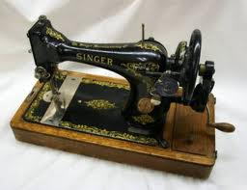
C. Electricity changes people’s lives
1. Electric sewing machines (Singer) made clothing cheaper
2. Refrigeration, indoor lights, etc.
Notes:
Elias Howe invented the first American sewing machine in 1846. It was used for fixing clothes at a factory use, and on production lines. The sewing machine was created in September 10,1846. The sewing machine was used for making blankets ,and clothing .It made sewing much easier ,and faster.
However, due to botched filing for a patent, Isaac Singer was the first to get a version of the sewing machine patented

Slide 8
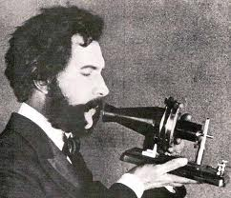
III. Advances in communications
The telegraph
The telephone
Invented by Alexander Graham Bell (1876)
Changed the way we communicate as a country
Video: The Invention of the Telephone
Notes:
On March 7, 1876, Bell was awarded a patent on the device, and three days later, he made his first successful telephone call to his assistant, electrician Thomas Watson, who would hear Bell's famous words transmitted through the wire: “Mr. Watson, come here. I want you.”
He was born on March 3, 1847, in Edinburgh, Scotland, to Prof. Alexander Melville Bell and his wife Eliza Grace Symonds. He had two brothers—Melville James Bell and Edward Charles Bell—both of whom died of tuberculosis.

Slide 9
Section Two
Advancement of the Railroads

Slide 10
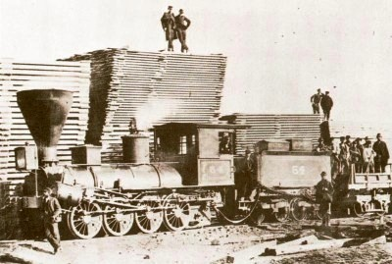
IV. Advances in railroads
Engines from steamboats were converted to power railroads
Popularity of railroads grew after the war
1. More standardized tracks
2. Safer travel
3. More tracks, more locations
Notes:
American railroads maintained many different time zones during the late 1800s. ... Operators of the new railroad lines needed a new time plan that would offer a uniform train schedule for departures and arrivals. Four standard time zones for the continental United States were introduced on November 18, 1883

Slide 11
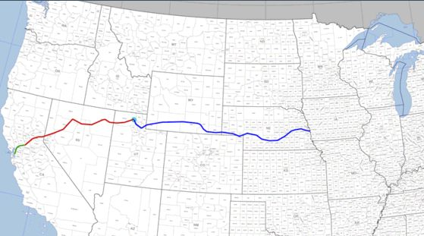
C. The Transcontinental Railroad
Abe Lincoln wanted to unite the nation
Tracks already went to the Miss. River
The transcontinental railroad was built from Omaha, NE to Sacramento, CA
United the nation and paid for by the government
Video: Railroad
Notes:
Six years after work began, laborers of the Central Pacific Railroad from the west and the Union Pacific Railroad from the east met at Promontory Summit, Utah. It was here on May 10, 1869 that Governor Stanford drove the Golden Spike (or the Last Spike), that symbolized the completion of the transcontinental railroad.

Slide 12
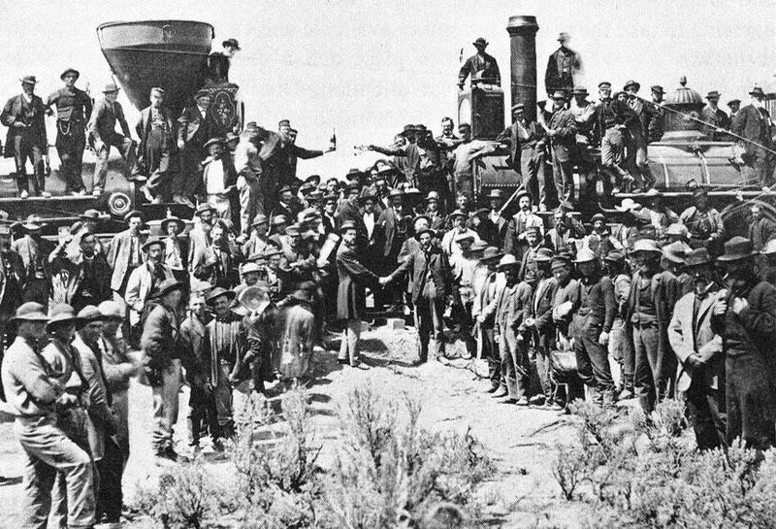
D. Creation of standard times and time zones

Slide 13
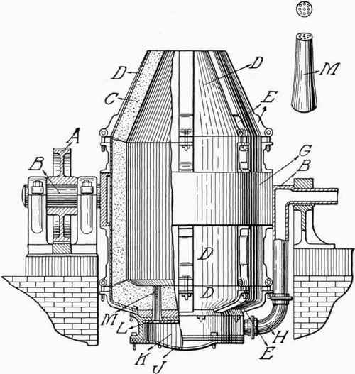
V. The Bessemer Process
A. Made it easier to mass produce steel
B. Steel was lighter, stronger, more flexible and cheaper to produce
C. Made advances in steel products possible
1. Skyscrapers
2. The Brooklyn Bridge
Video: Bessemer Process
Notes:
The Bessemer process was the first inexpensive industrial process for the mass production of steel from molten pig iron before the development of the open hearth furnace. The key principle is removal of impurities from the iron by oxidation with air being blown through the molten iron.

