Slide 1
3/26 - Reconstruction
I. 20 minutes – Civil War & Reconstruction worksheet
II. 20 minutes – Notes on Reconstruction
III. 20 minutes – Reconstruction Reading with questions

Slide 2
Reconstruction

Slide 3
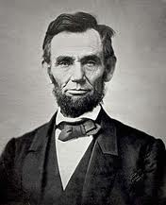
Lincoln’s plan
Lincoln’s Reconstruction Plan
Lincoln did not believe the Confederate states were legitimate

Slide 4
Lincoln’s Ten Percent Plan (Dec. 1863)
Pardoned any Confederate who would pledge allegiance to the Union
Denied pardons to Confederate officers, members of the government, and those who murdered AA war prisoners
States could create a new constitution after only 10% had sworn allegiance to the Union
States could then hold elections and fully participate in the Union

Slide 5
With malice towards none, charity for all….
Lincoln’s Second Inaugural Address
Lincoln did not believe the south should be punished
“With malice toward none; with charity for all . . .”

Slide 6
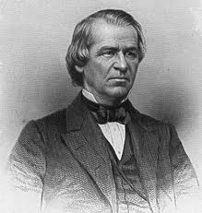
Johnson’s Plan
Johnson’s Reconstruction Plan
Andrew Johnson became president upon Lincoln’s death
Johnson’s plan for Reconstruction was similar to Lincoln’s, however, it was more lenient on the south

Slide 7
Radical Republicans
III. Radical Republicans vs. Andrew Johnson
A. President Johnson was from the south and wanted to be lenient
B. Radical Republicans controlled the Congress and attempted to pursue harsh treatment of the south

Slide 8
Radical Republican plans
1. Southern states were ruled under martial law (federal troops in South to ensure protection for freed blacks)
2. Temporarily barred former Confederates from voting
3. Forced the south to agree to and enact the three new Amendments, especially the equal rights section

Slide 9
Johnson Fights Back!
C. Johnson fights back
1. Johnson fires Radical Rep. leader Edwin Stanton
2. Congress impeaches Johnson for this act
3. Johnson stays in office by one vote

Slide 10
13th Amendment
The Amendments
A. The Thirteenth Amendment
1. Passed immediately after the war
2. Made the institution of slavery forever illegal on American soil

Slide 11
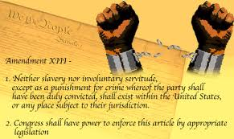

Slide 12
14th Amendment
B. The Fourteenth Amendment
1. Equal rights Amendment
2. Guaranteed all Americans to equal protection under the law

Slide 13
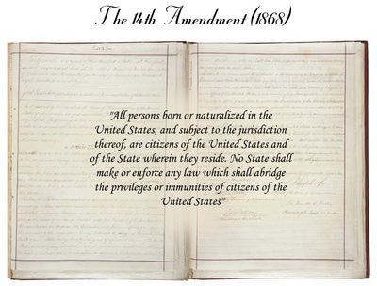

Slide 14
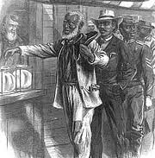
15th Amendment
C. The Fifteenth Amendment
1. Everyone (except women) was guaranteed the right to vote
2. “Race, color, or previous servitude” could not be determining voting conditions

Slide 15
Election of 1876
Reconstruction ends
People grow tired of Reconstruction
The Compromise of 1877
Election of 1876 end in a tie
Democrats allow the Republican candidate to win in exchange for the ending of Reconstruction
“Jim Crow” era of American history begins

Slide 16
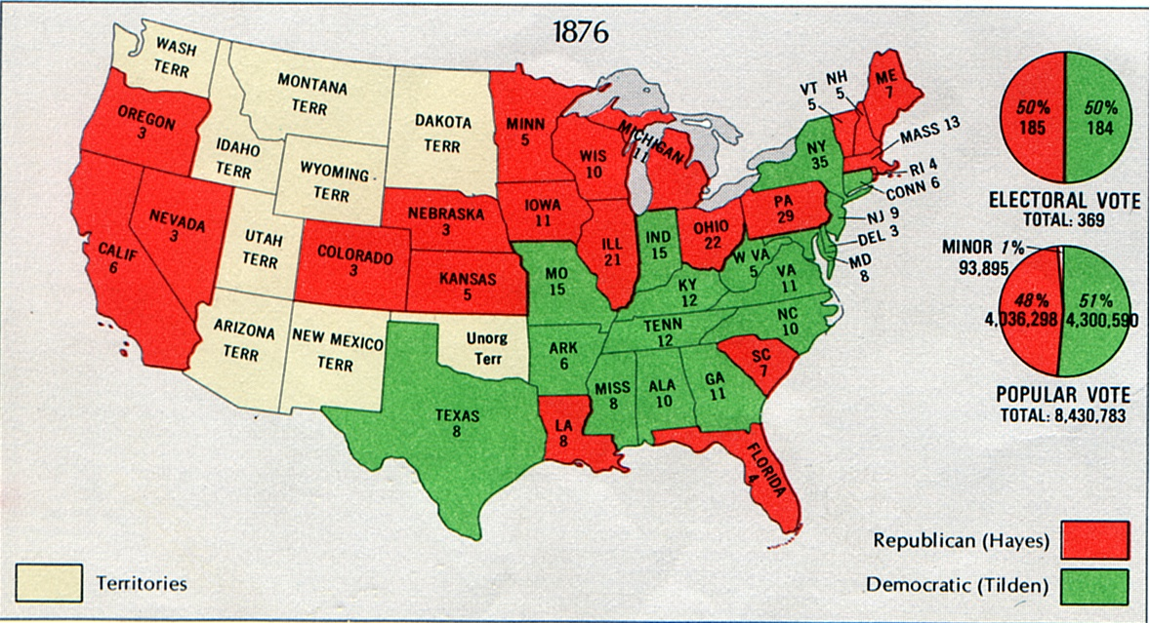
Election of 1876

Slide 17
3/27 – 1 Day until Carter’s Birthday!
I. Review Reconstruction / Civil War
II. Finish Reconstruction Worksheet
III. Civil War Unit Test
IV. Immigration Reading/Worksheet| THINGS TO BE DONE TODAY AFTER TEST: -Reconstruction Worksheet (from yesterday) -Immigration Reading worksheet -Tomorrow: Reconstruction Open-Note Quiz (10?’s) -Carter’s Birthday—make a card Objective: Students will be able to explain reasons for immigration, as well as some of the difficulties faced by immigrants.

