Slide 1
Unit Two, Section Five: Immigration
Politics, Immigration, and Urban Life (1870-1915)

Slide 2
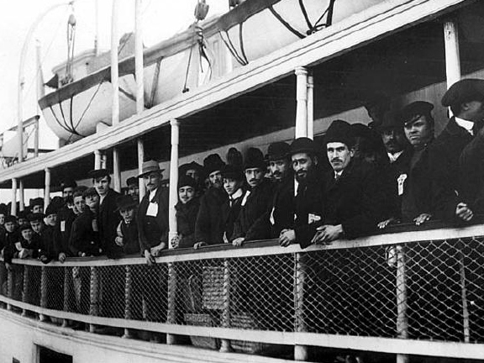
I. Immigration during the Gilded Age
A. Immigration before 1871
Primarily from western Europe
Germany, Great Britain, Ireland, Norway, Sweden

Slide 3
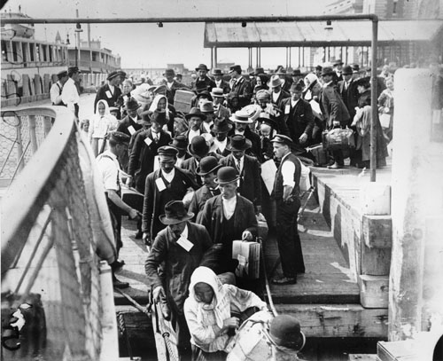
B. Immigration after 1871
Primarily from southern and eastern Europe
Southern Italy, Greece, Poland, Russia, Yugoslavia
Asia (China and Japan)

Slide 4
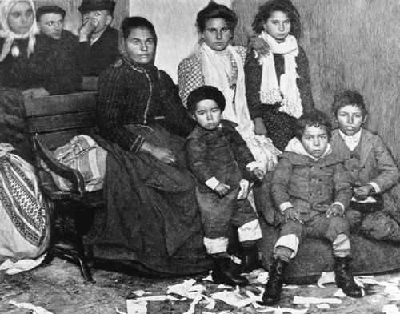
II. The lives of immigrants
A. Most came in search of a better life
Most European countries suffered huge gaps between the rich and poor
America was rumored to be the land of opportunity and equality
Russian Jews came to escape religious intolerance

Slide 5
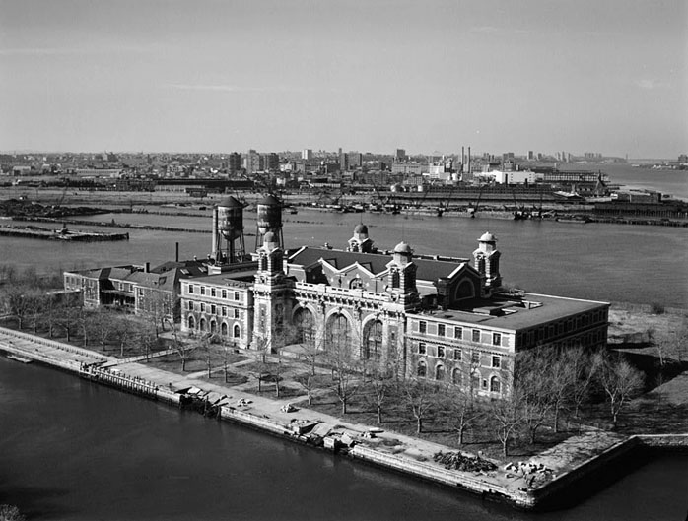
B. Immigrants arrived at several entry ports around the country
San Francisco, Seattle, Boston, Philadelphia
Ellis Island, New York was the main point of entry, “the Golden Door”

Slide 6
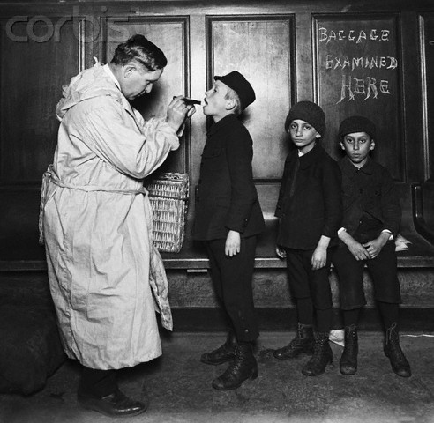
C. Treatment of the immigrants
Immigrants were forced to undergo physical exams upon entry
Those who were sick were quarantined

Slide 7
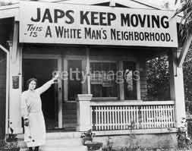
3. Most immigrants suffered discrimination
Spoke unknown languages
Practiced different religions
Chinese Exclusion Act of 1882
Japanese immigrants were banned from owning farm land

Slide 8
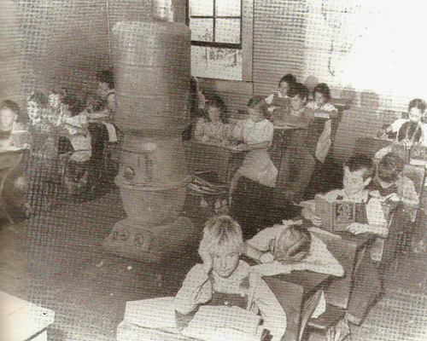
4. White, European immigrants were integrated easier 5. Public schools played a critical role in assimilating immigrants into American society

Slide 9
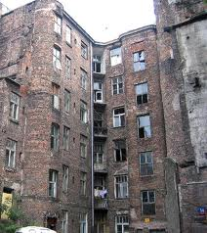
III. Settlement of the Immigrants
A. Immigrants settled in areas near others like themselves
Regions of the country (Germans-Midwest)
Ethnic neighborhoods (Chinatown, Little Italy, etc.)
Ghettos (ethnic neighborhoods)

