Slide 1
Conducting Research

Slide 2
Steps in Scientific Method
State the problem/Form the question
Form a hypothesis (educated guess)
Test the hypothesis
Analyze the results
Draw conclusions
Does it replicate?
What are some new questions that can be asked?

Slide 3
Form a question
1st step in method
Often based on every day behaviors
Constructs – Things that cannot be seen, touched, or measured directly
Because of constructs, most research is based on behaviors, not thoughts
Questions arise from daily experience, psychological theory, folklore, etc…
Are two heads better than one?

Slide 4
Form a hypothesis
After forming a question, make an educated guess about the answer (hypothesis)
May be an ‘if-then’ statement

Slide 5
Test Hypothesis
It cannot be considered true until it is scientifically tested and proven

Slide 6
Analyze Results
Determine what findings mean
Patterns and relationships within data
The more data, the more complex

Slide 7
Draw Conclusions
If data does not align with hypothesis, must often change the belief/hypothesis

Slide 8
Replication?
In order for study to be valid, must be able to be replicated with same results
Should perform studies on various genders, ages, ethnicities, etc… to ensure validity
Once study is completed, new questions may arise and process starts over

Slide 9
Methods of Observation – Survey Method
Description - People respond to a series of questions on a subject
Advantages- Enables researchers to gather info about large numbers of people
Disadvantages – People may not be honest; Survey samples may not reflect target population

Slide 10
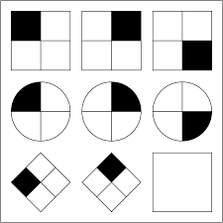
Methods of Observation – Testing Method
Description – Measures various elements of human behavior (personality; ability) through testing
Advantages – Enables researcher to gain insight into certain aspects of an individual’s behavior
Disadvantages – Does not always provide complete representation of an individual’s true personality

Slide 11
Method of Observation – Case-Study
Description: In depth investigation of individual or small groups
Advantage: Provides insight to specific cases
Disadvantage: Interviewees may distort their past; Researchers may influence the answers (unintentionally, of course)

Slide 12
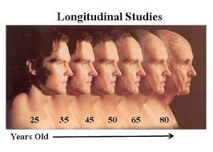
Methods of Observation - Longitudinal
Description – Group of participants are observed at intervals over an extended period of time
Advantages – Enables researches to see how individuals change over time
Disadvantages – Time consuming; expensive; participants may not be available later on

Slide 13
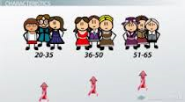
Cross-Sectional
Description – Compare the differences and similarities among people in different age groups at a given time
Advantage - Less time consuming than longitudinal
Disadvantages- Differences between the different groups could be for many reasons, so not as accurate

Slide 14
Naturalistic
Observing behavior of people/animals in natural habitats
Advantage- Witness subjects in real setting
Disadvantage – Researchers have no control over setting; their presence may influence behaviors

Slide 15
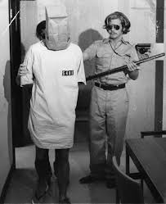
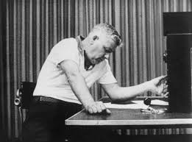
Laboratory Observation
Participants are observed in lab setting
Advantage – Very precise in controlling study
Disadvantage- Labs cannot duplicate real-life environments

Slide 16
Experimental Method
Administer treatment, then observe to see how treatment influences behavior
Adv – Can manipulate variables and determine cause/effect
Disadv-Lab may not replicate real life; bias or ‘placebo effect’

Slide 17
Question:
If someone told you to hurt another person that you did not know (and was no threat to you or anyone else), would you do it?
What if that person was an authority?

Slide 18
Experimental Method

Slide 19
The Experimental Method
In an experiment, participants receive a treatment (change in room temperature; a drug; etc…)
Researchers carefully observe the participants to determine how the treatment influences their behavior

Slide 20
Independent and Dependent Variables
Independent Variable: the factor that researchers can manipulate so that they can determine its effect
Dependent Variable: The factor that is being measured; responds to independent variable

Slide 21
Experimental v. Control Group
Experimental Group: The group that receives the treatment
Control Group: The group that does not receive the treatment
Controlled Experiment: An experiment that uses control and experimental groups

Slide 22
Placebo Effect
Placebo: a substance or treatment that has no effect apart from a person’s belief in it

Slide 23
Single-Blind vs. Double Blind Studies
Single Blind: A study in which the participants are unaware of whether they are in the control group or the experimental group
Double Blind: An experiment in which neither the participant nor the researcher knows whether the participant has received the treatment or the placebo
Required by Food and Drug Administration
Results remain unbiased

Slide 24
Activity
Pretend that you’ve done a controlled experiment. The experiment studies the effect of caffeine on student test scores. Write an imaginary report that explains the findings (you may make them up). Write what the study was about, stating the independent variable, the dependent variable, and the placebo. Include single-blind or double-blind study. If you want, you can make up your own study.

