Slide 1
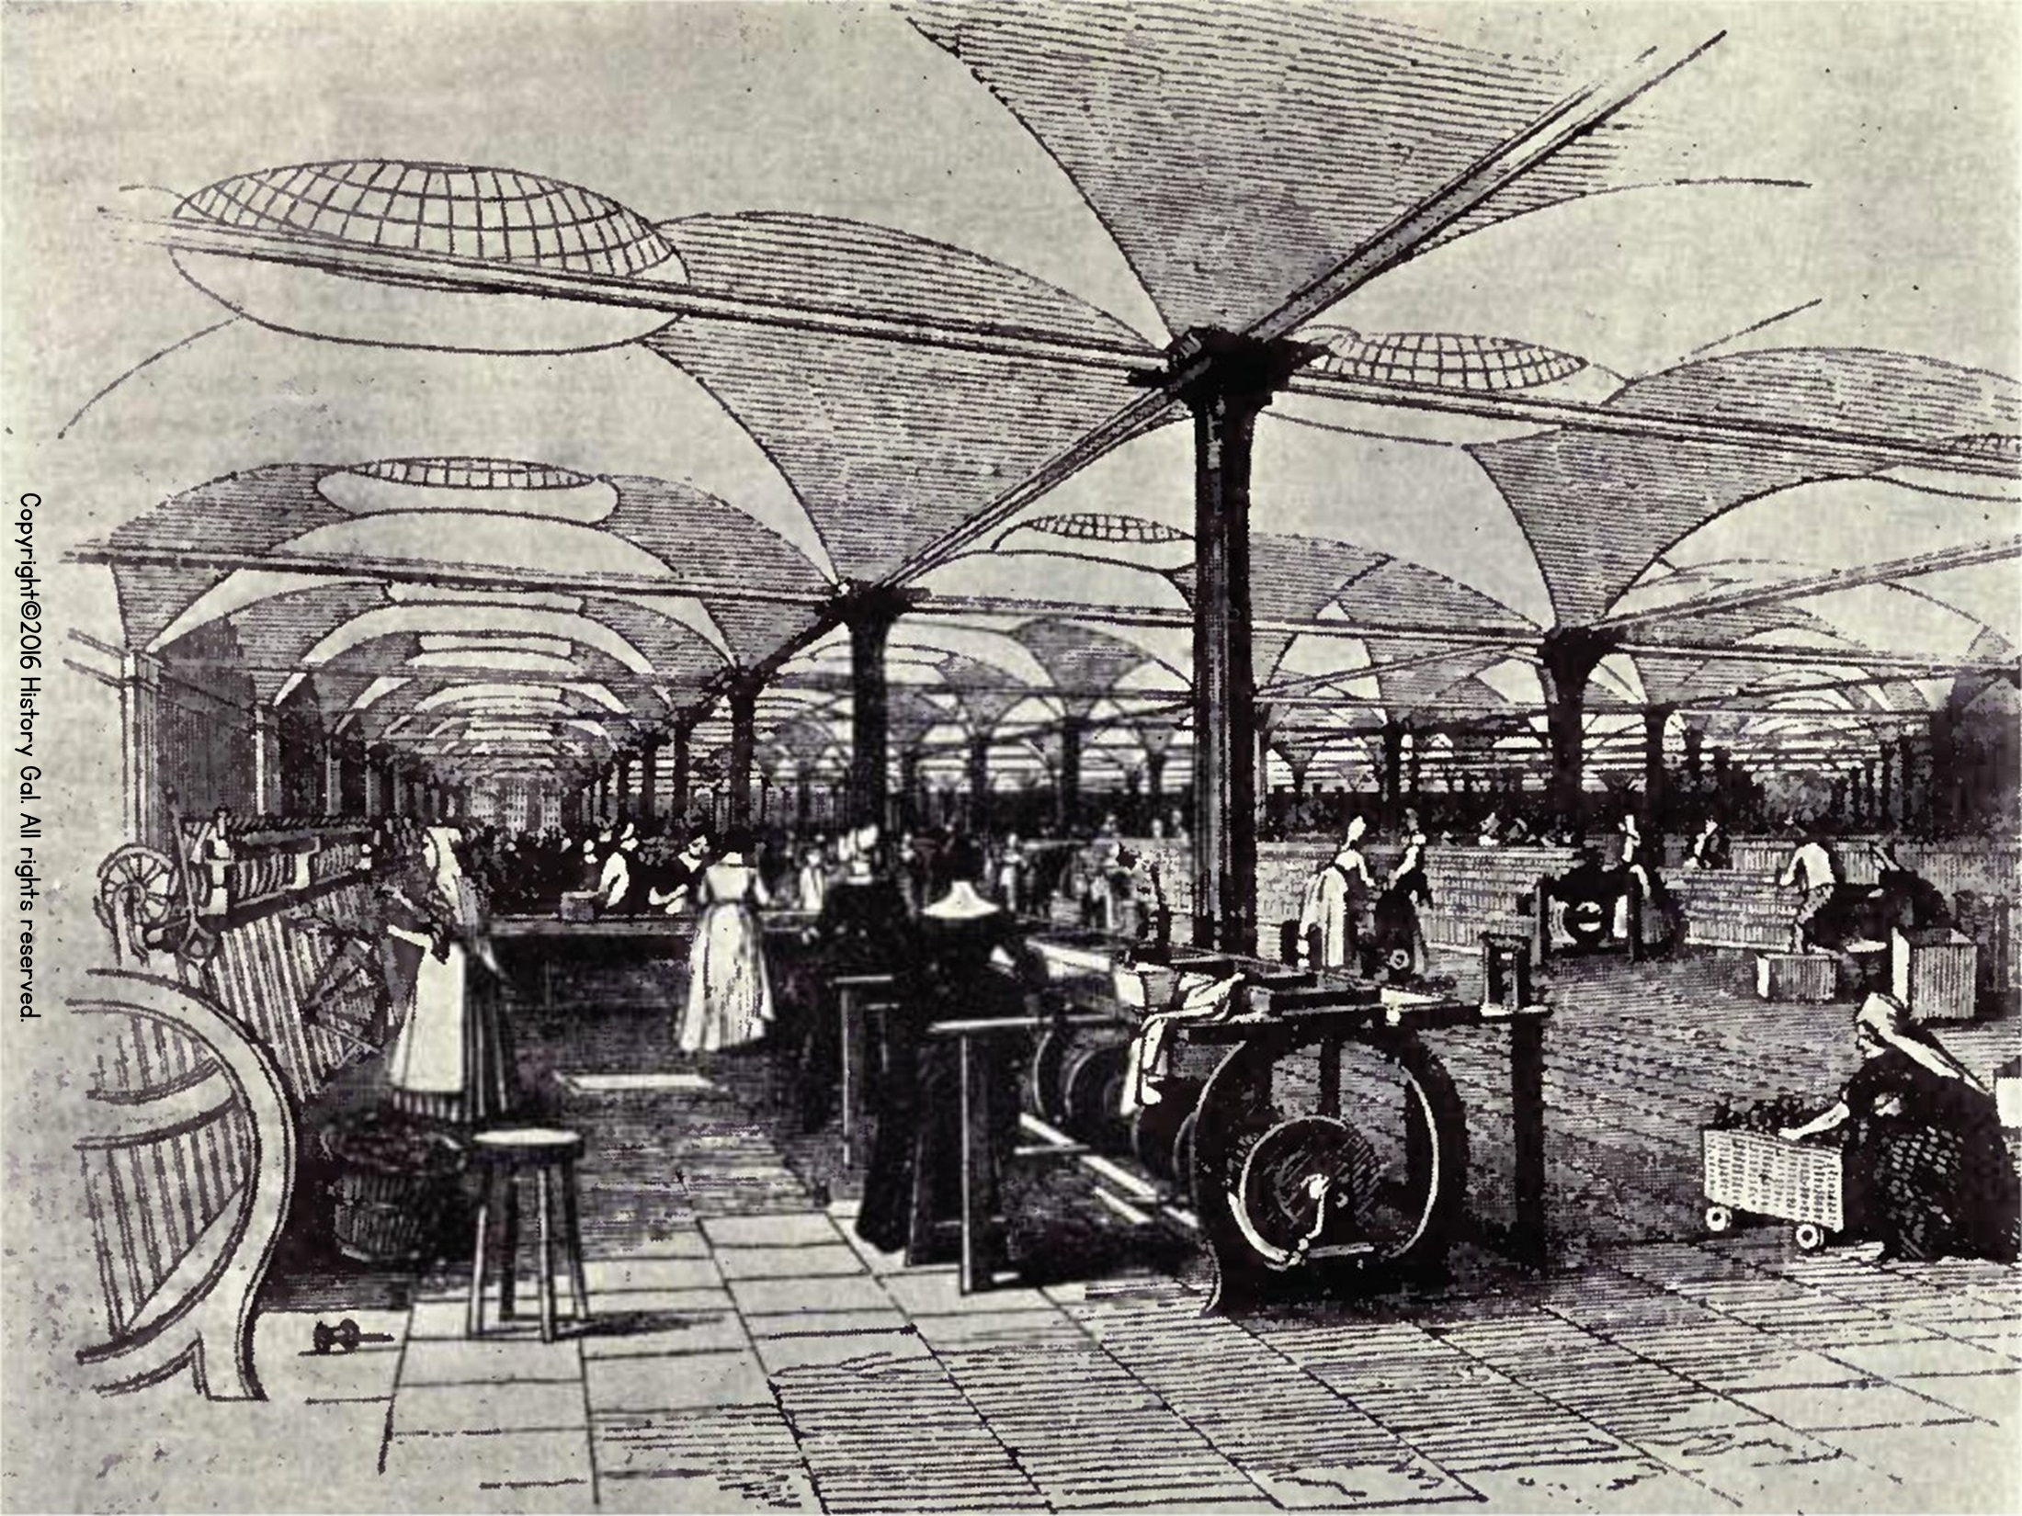
Rise of Industrial America 1865-1900

Slide 2
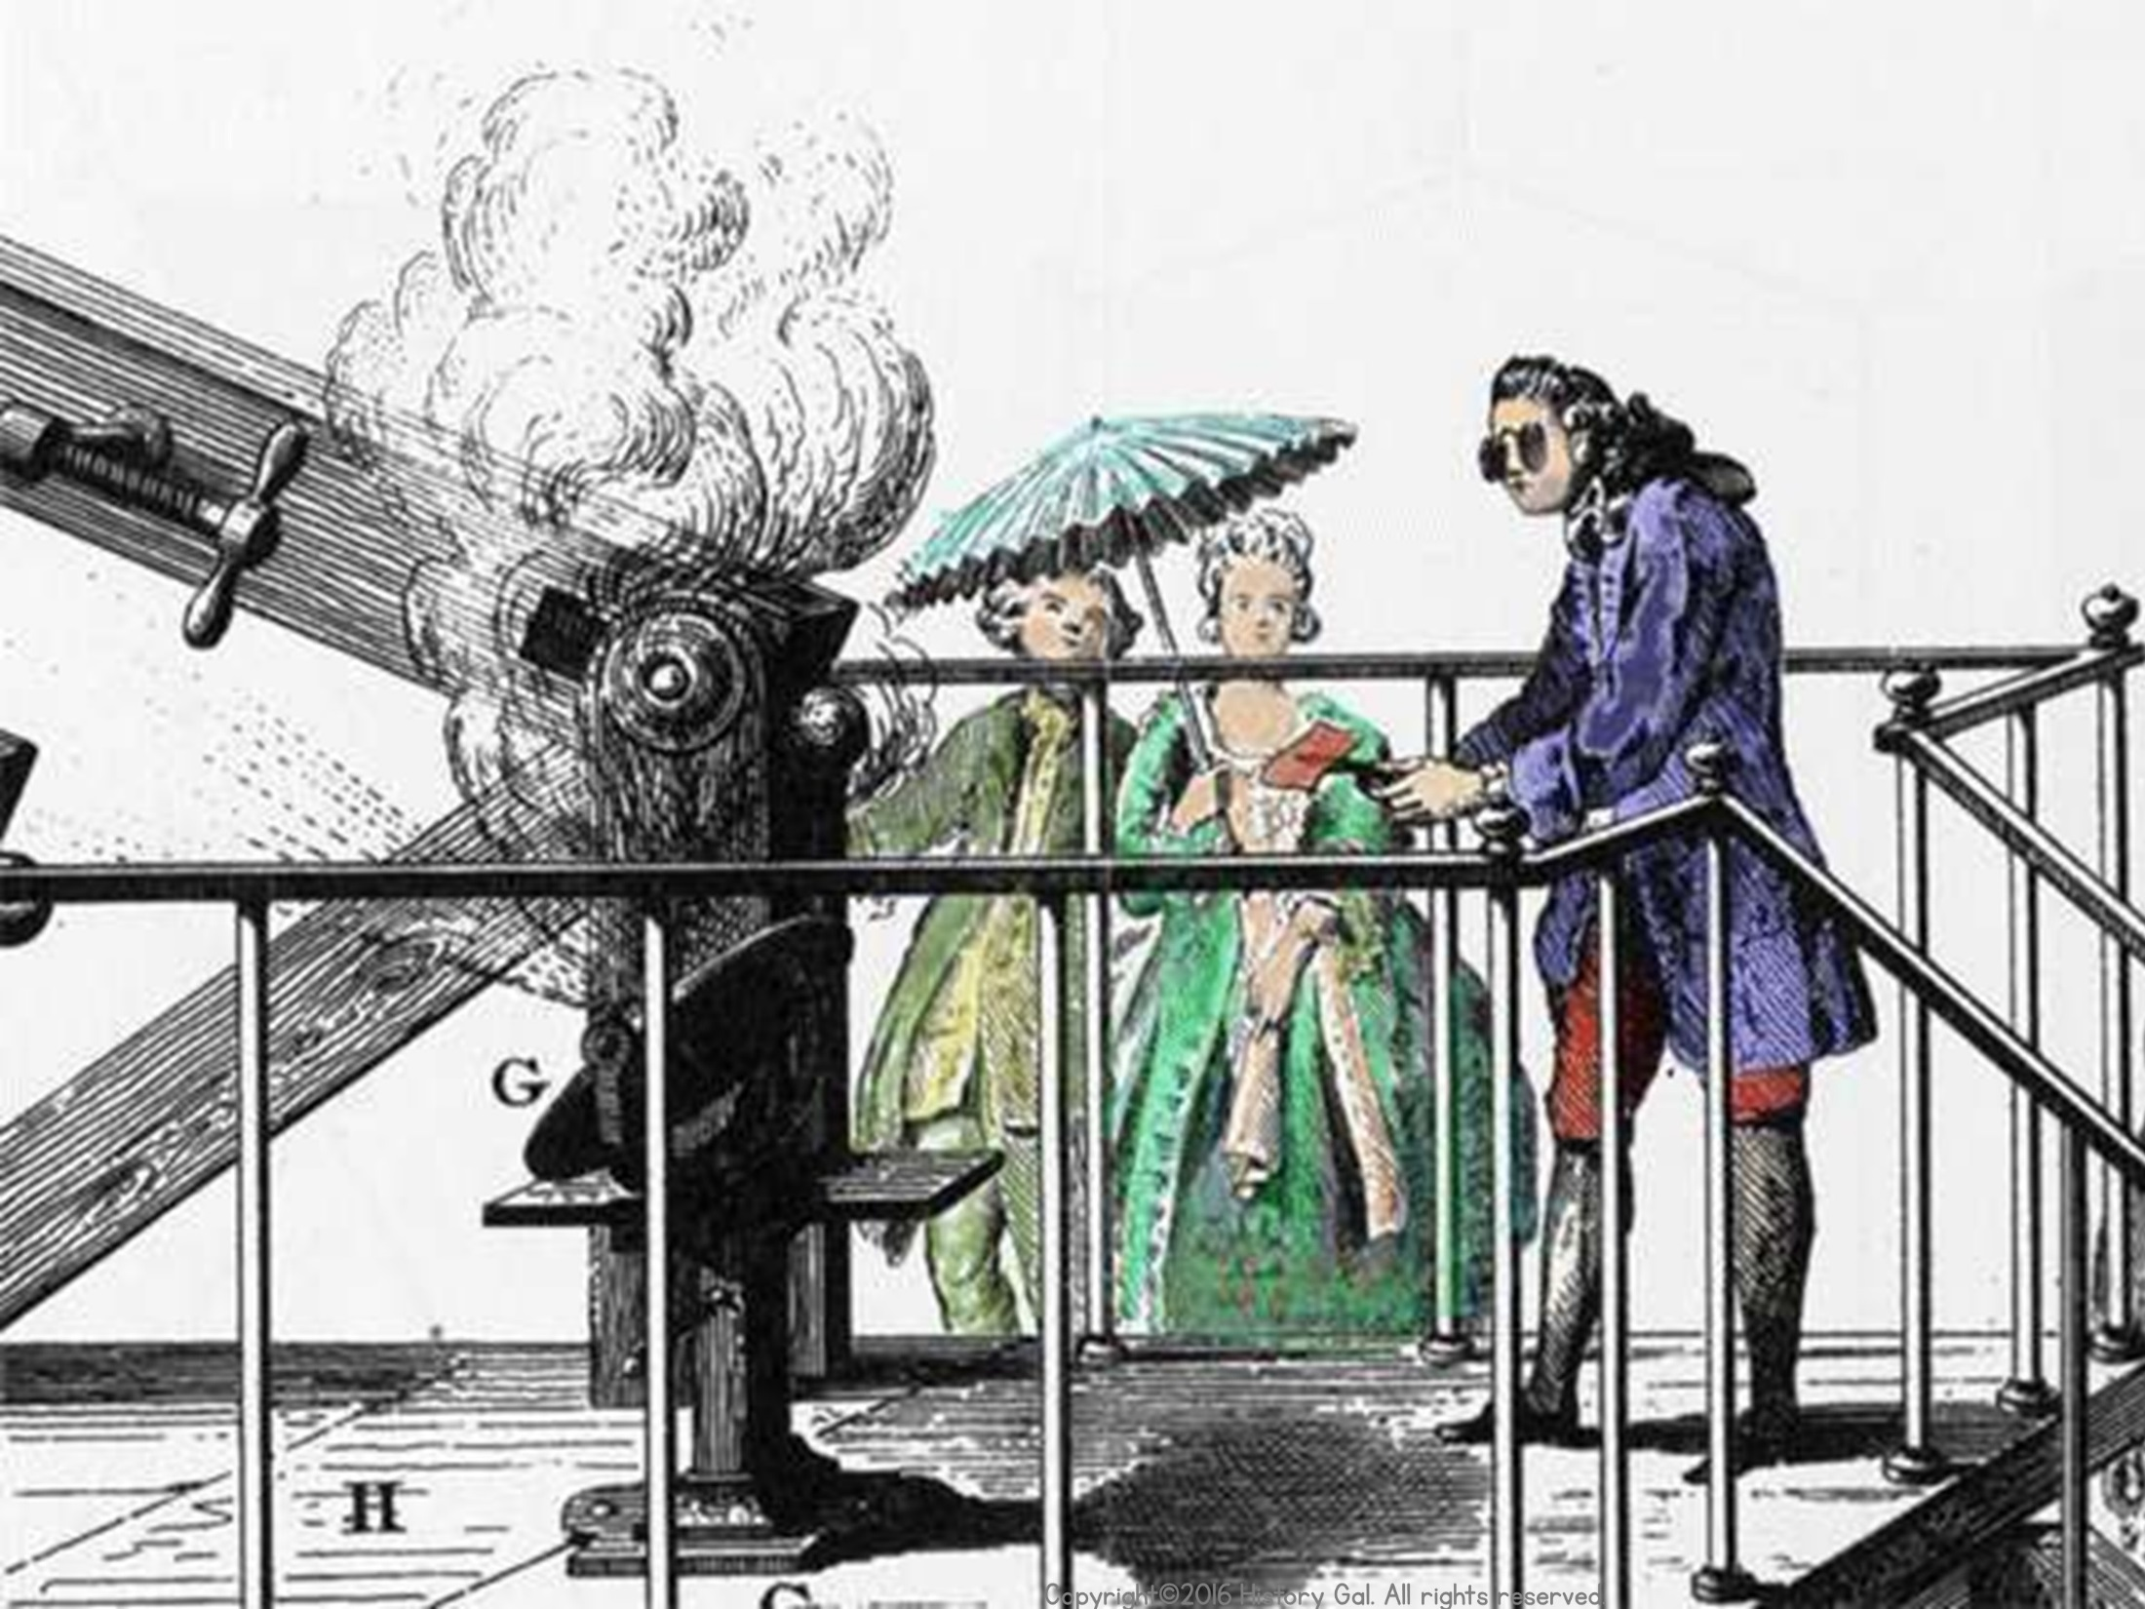
Robber Barons or Captains of Industry
Copyright©2016 History Gal. All rights reserved.

Slide 3
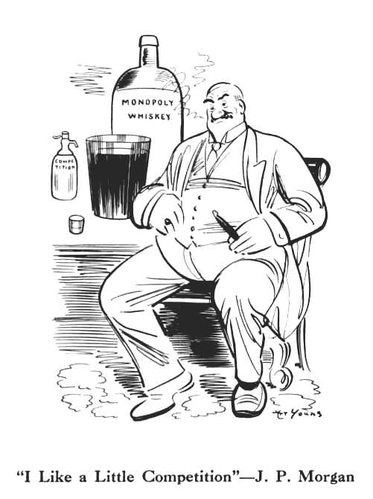
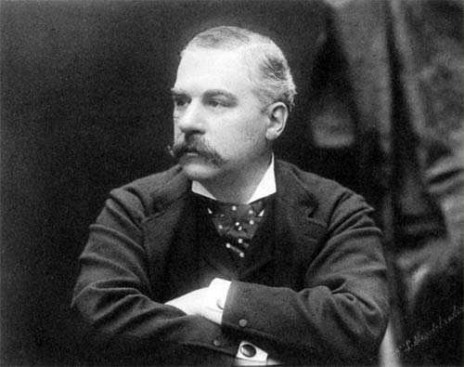
ROBBER BARONS OR
CAPTAINS OF INDUSTRY?
JP Morgan:
Made his fortune in Banking, Finance

Slide 4
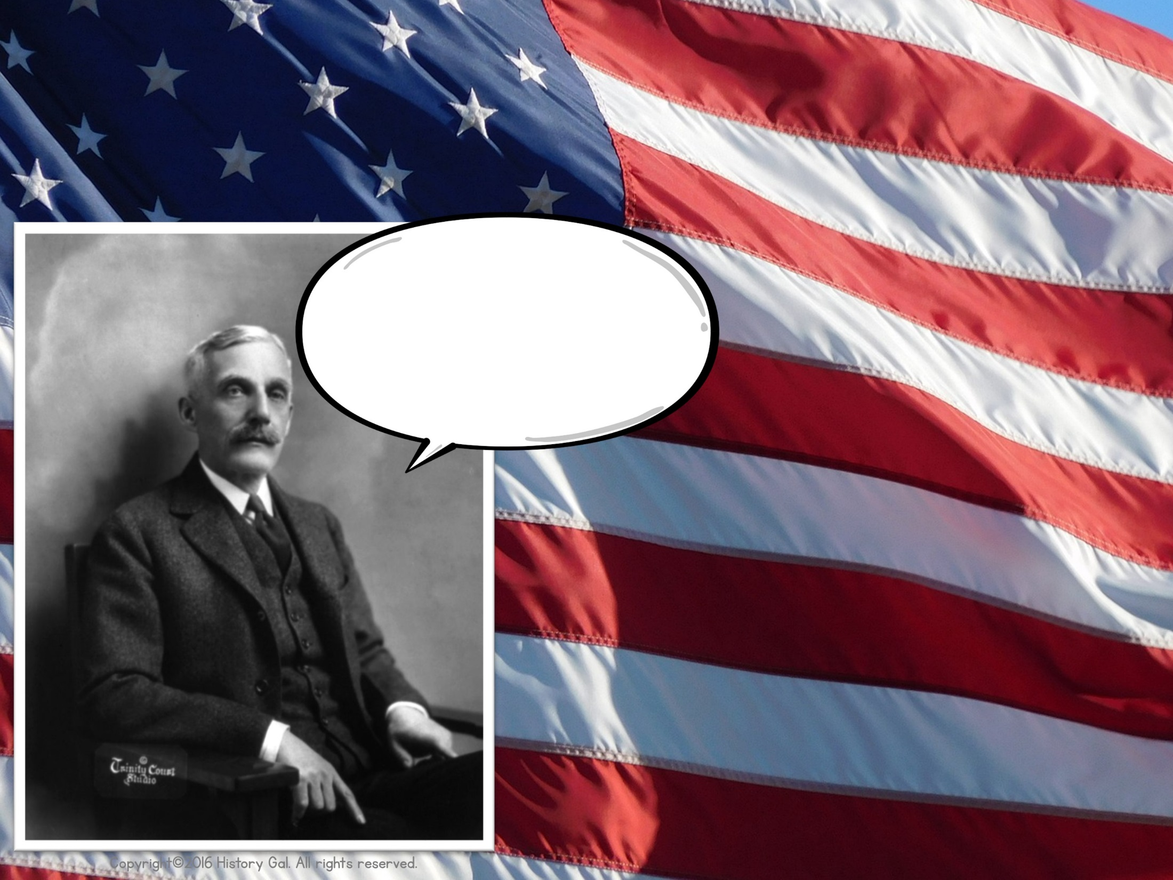
ROBBER BARONS OR
CAPTAINS OF INDUSTRY?
“Give tax breaks to large corporations, so that money can trickle down to the general public, in the form of extra jobs.”
Andrew W. Mellon:
Made his fortune in finance and oil

Slide 5
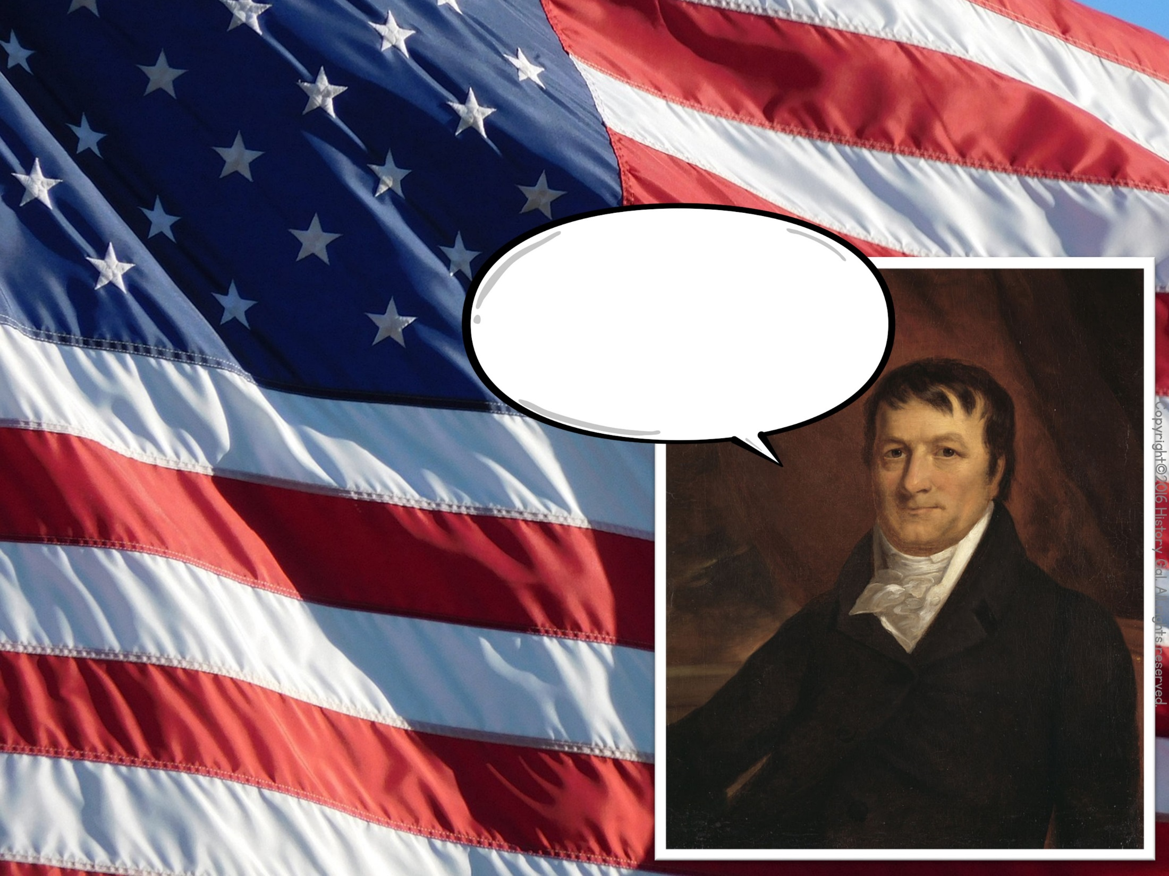
ROBBER BARONS OR
CAPTAINS OF INDUSTRY?
“The first hundred thousand - that was hard to get, but afterwards, it was easy to make more.”
John Jacob Astor:
*Made his fortune in real estate and fur
*He was the first multi-millionaire in US
*His great-grandson died on Titanic in 1912

Slide 6
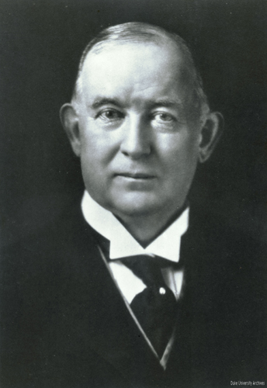
ROBBER BARONS OR
CAPTAINS OF INDUSTRY?
James B. Duke:
Made his fortune in cigarette manufacturing and marketing

Slide 7
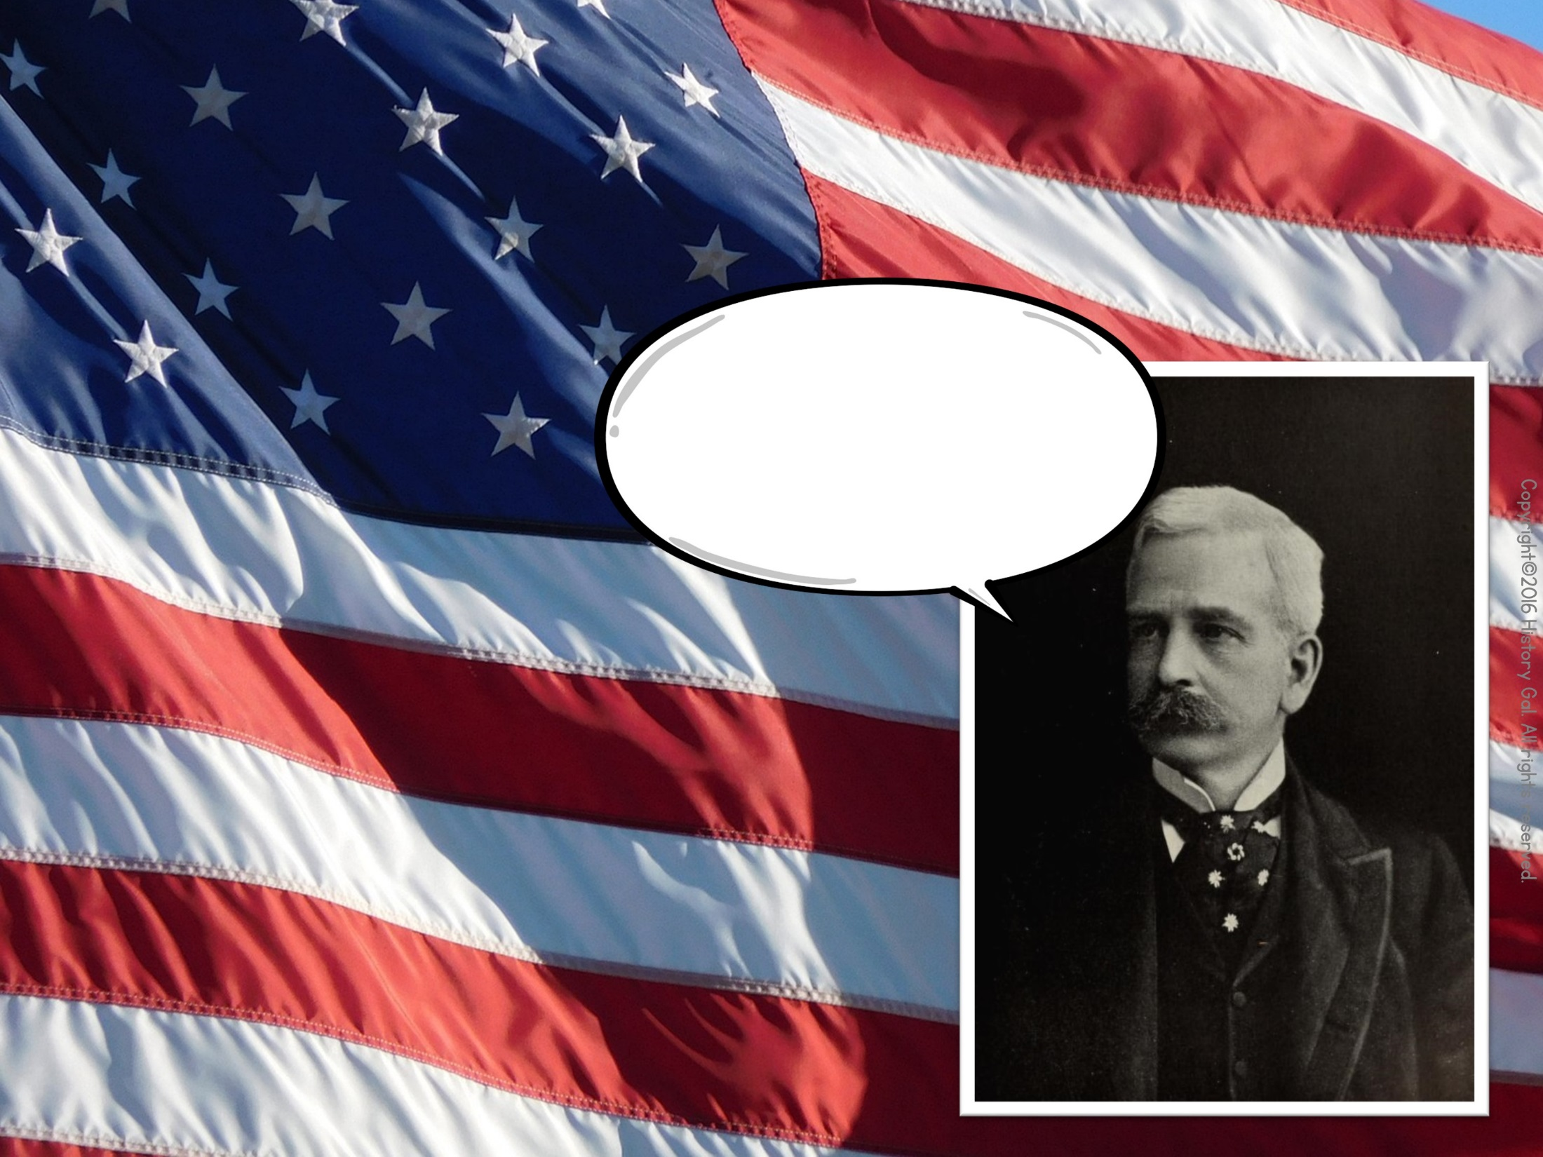
ROBBER BARONS OR
CAPTAINS OF INDUSTRY?
“Goodwill is the only asset that competition cannot undersell or destroy.”
Marshall Field:
Made his fortune in retail
PBS Article about Field

Slide 8
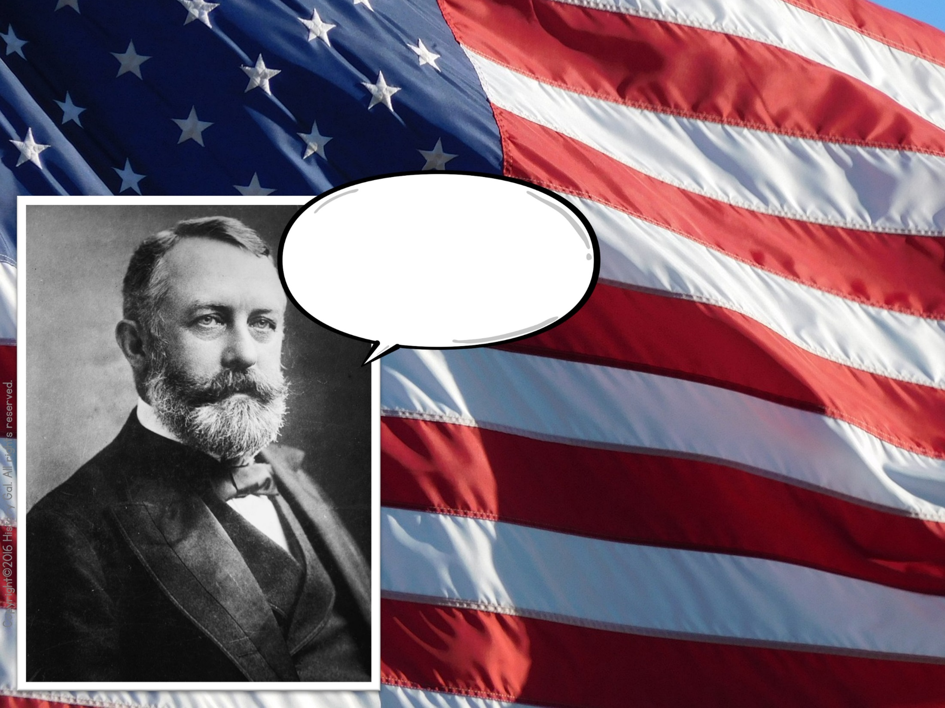
ROBBER BARONS OR
CAPTAINS OF INDUSTRY?
I “was twice shot, but not dangerously” by an anarchist in 1882.
Henry Clay Frick:
Made his fortune in steel

Slide 9
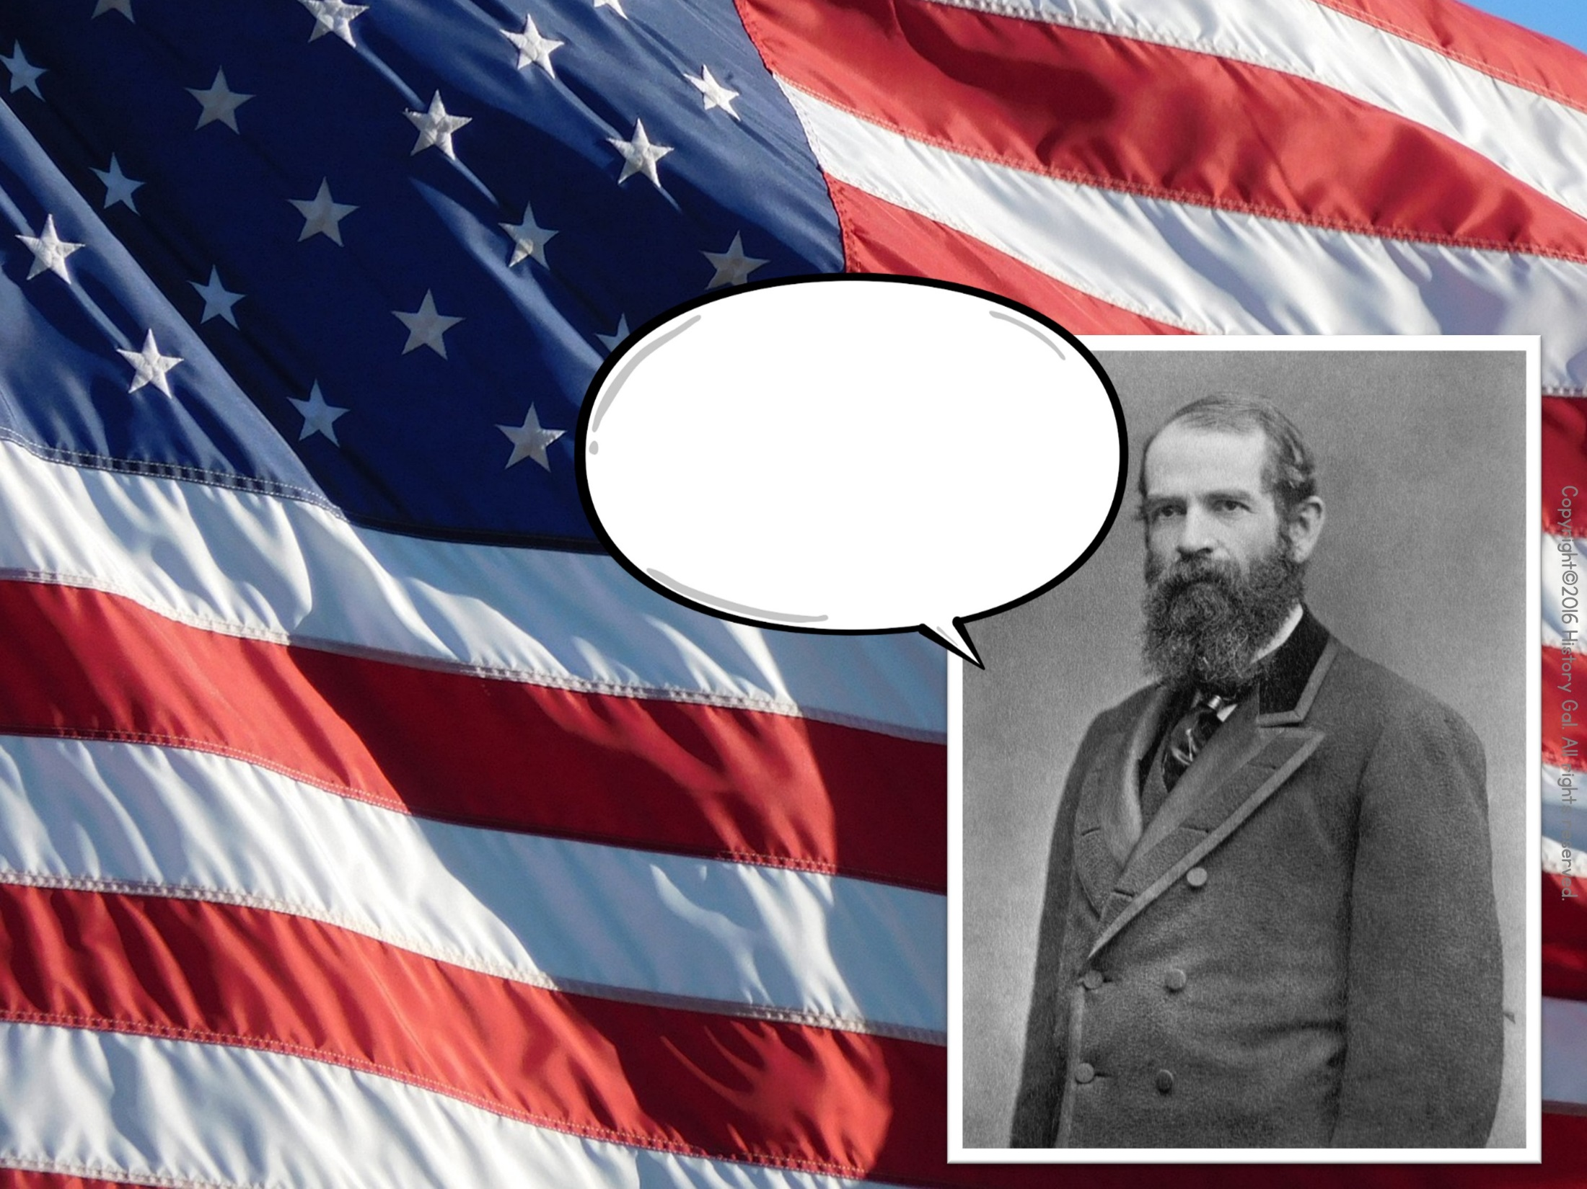
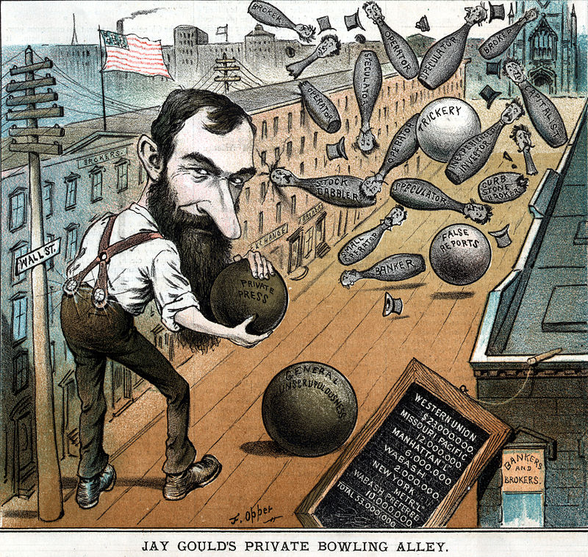
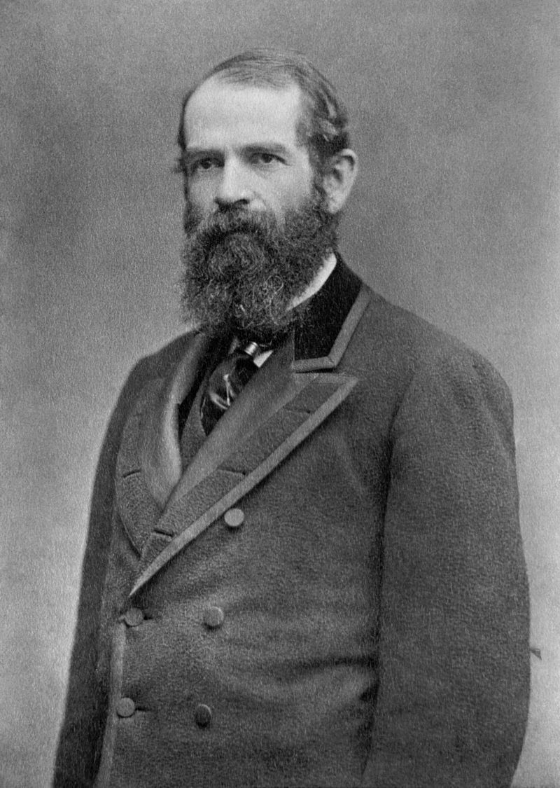
ROBBER BARONS OR
CAPTAINS OF INDUSTRY?
“Corporations are going, we are told, to destroy the country. But what would this country be but for corporations? Who have developed it? Corporations. Who transact the most marvelous business the world has ever seen? Corporations.”
Jay Gould:
Made his fortune in Railroads

Slide 10
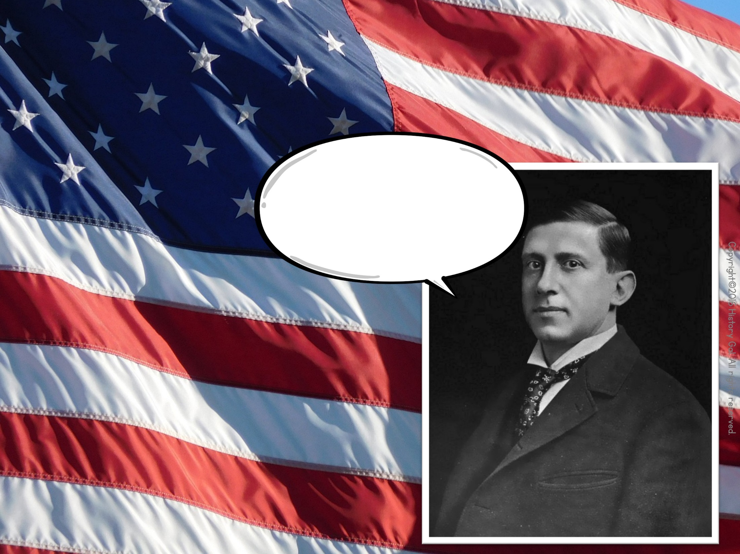
ROBBER BARONS OR
CAPTAINS OF INDUSTRY?
“I will not be in the position of having management dictated to by labor.”
Charles Schwab:
Made his fortune in steel

Slide 11
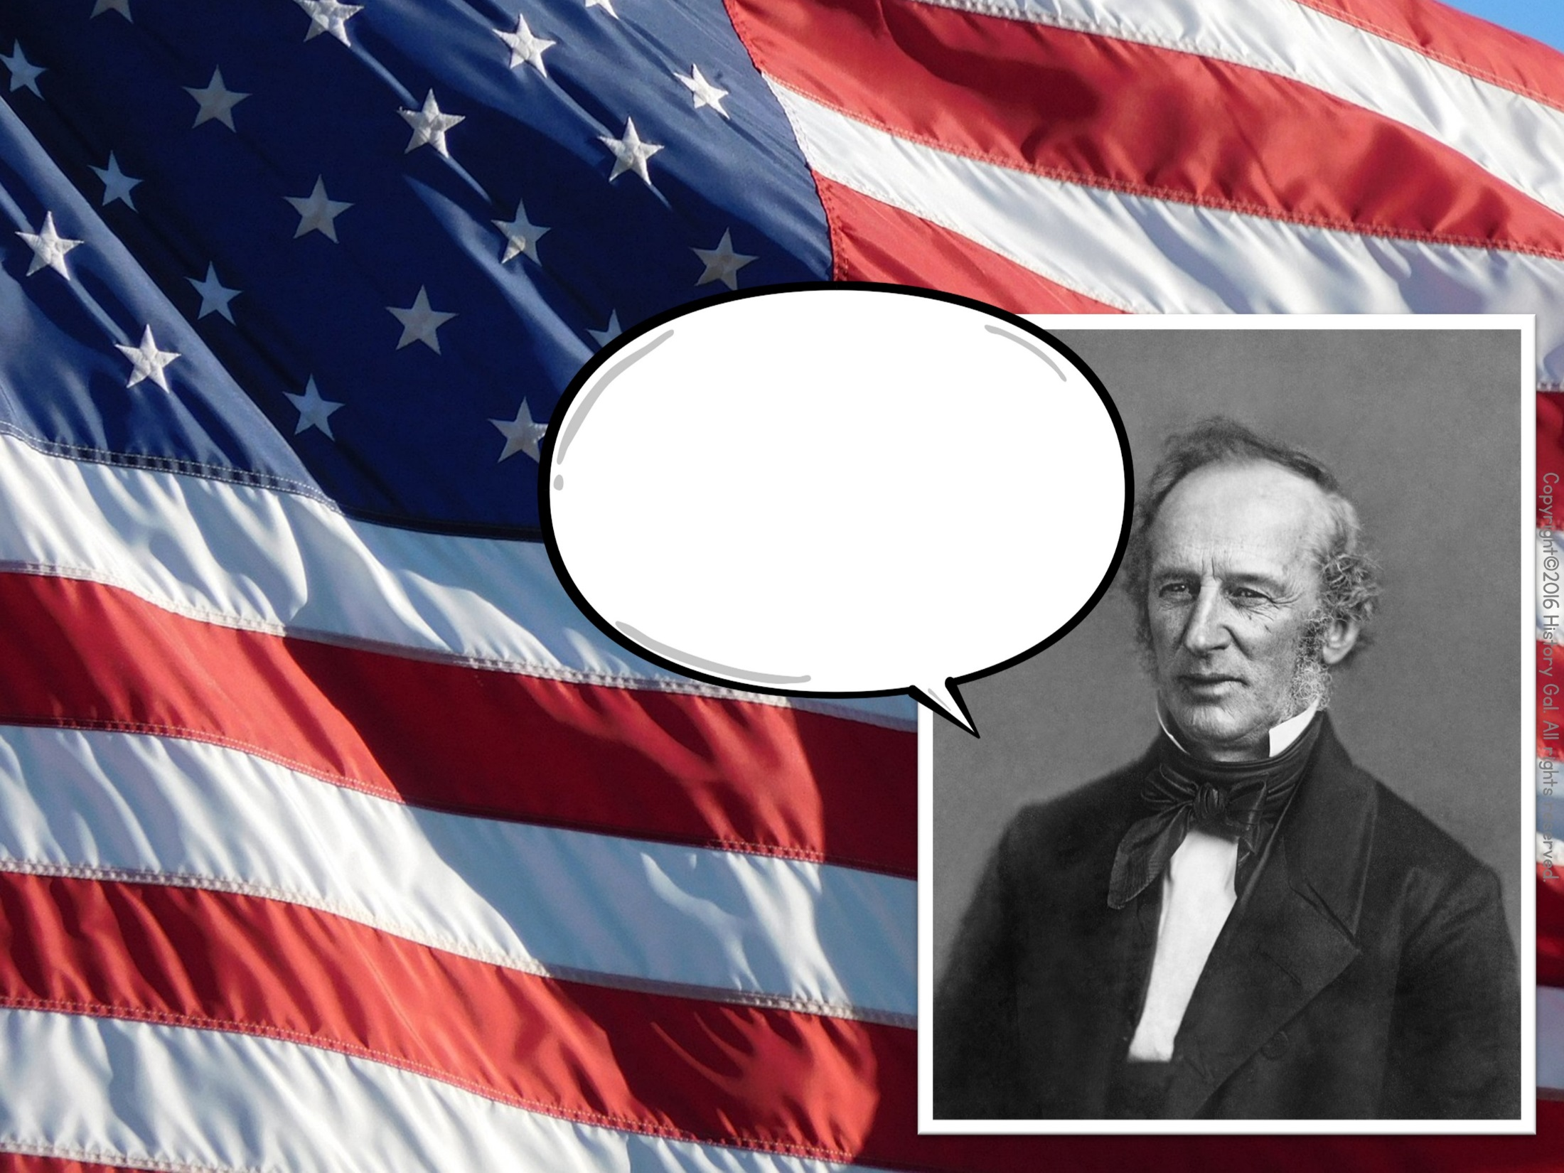
ROBBER BARONS OR
CAPTAINS OF INDUSTRY?
“I have always served the public to the best of my ability. Why? Because, like every other man, it is to my interest to do so.”
Cornelius Vanderbilt:
Made his fortune in RRs and water transport

Slide 12
Technology and Innovation
Copyright©2016 History Gal. All rights reserved.

Slide 13
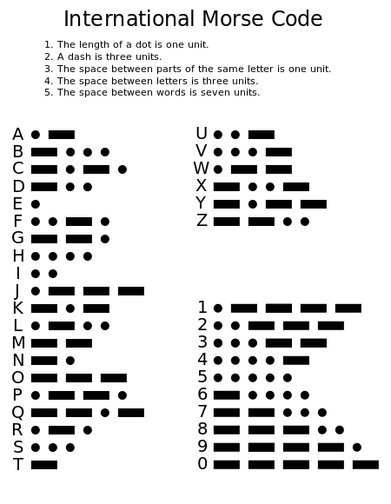
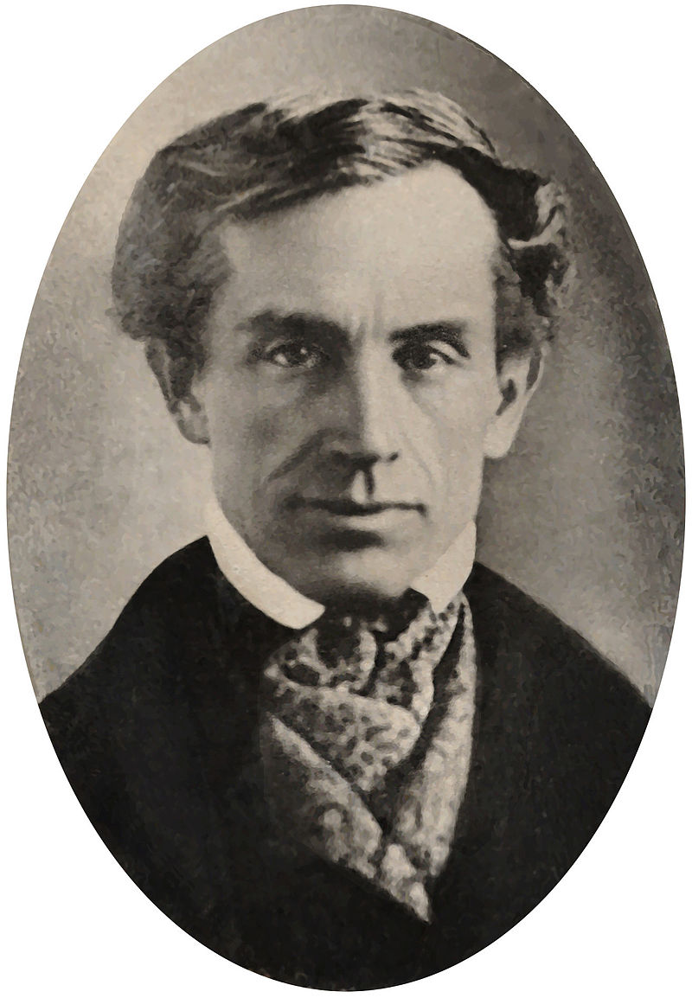
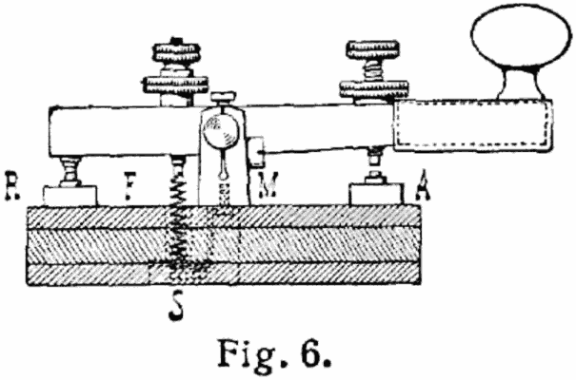
Samuel B. Morse’s telegraph
(Western Union) - 1844

Slide 14
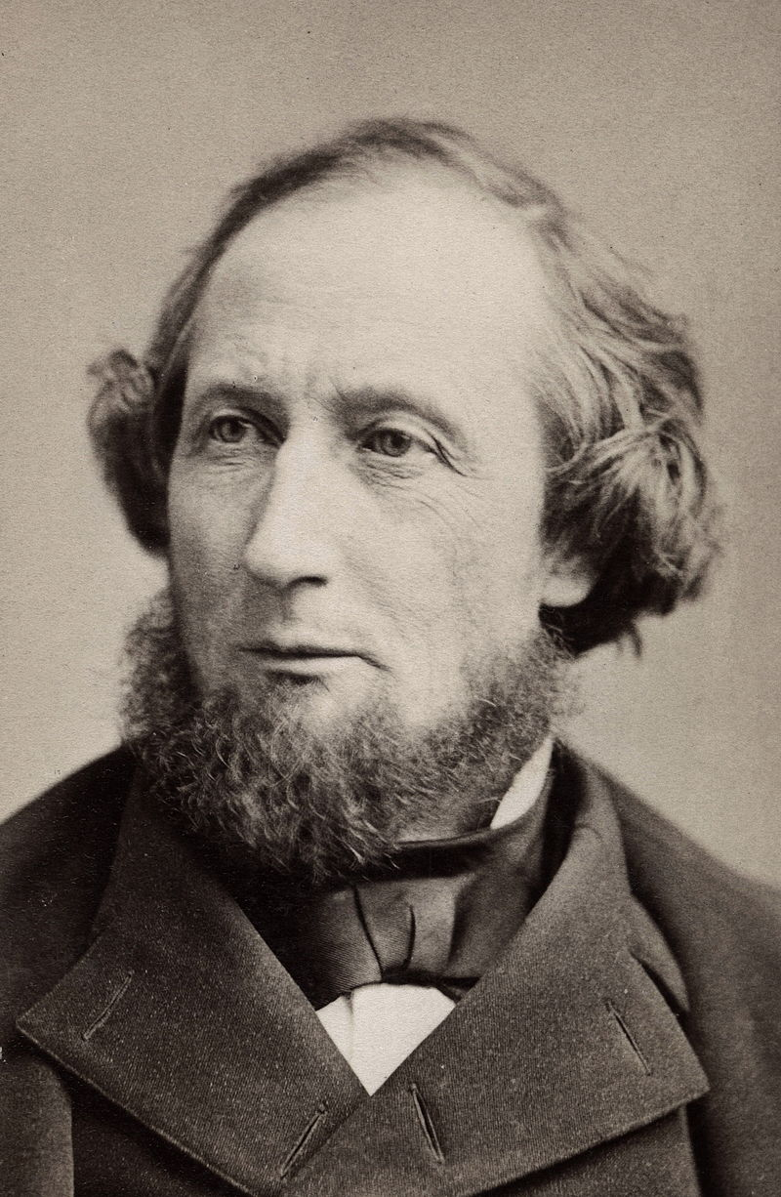
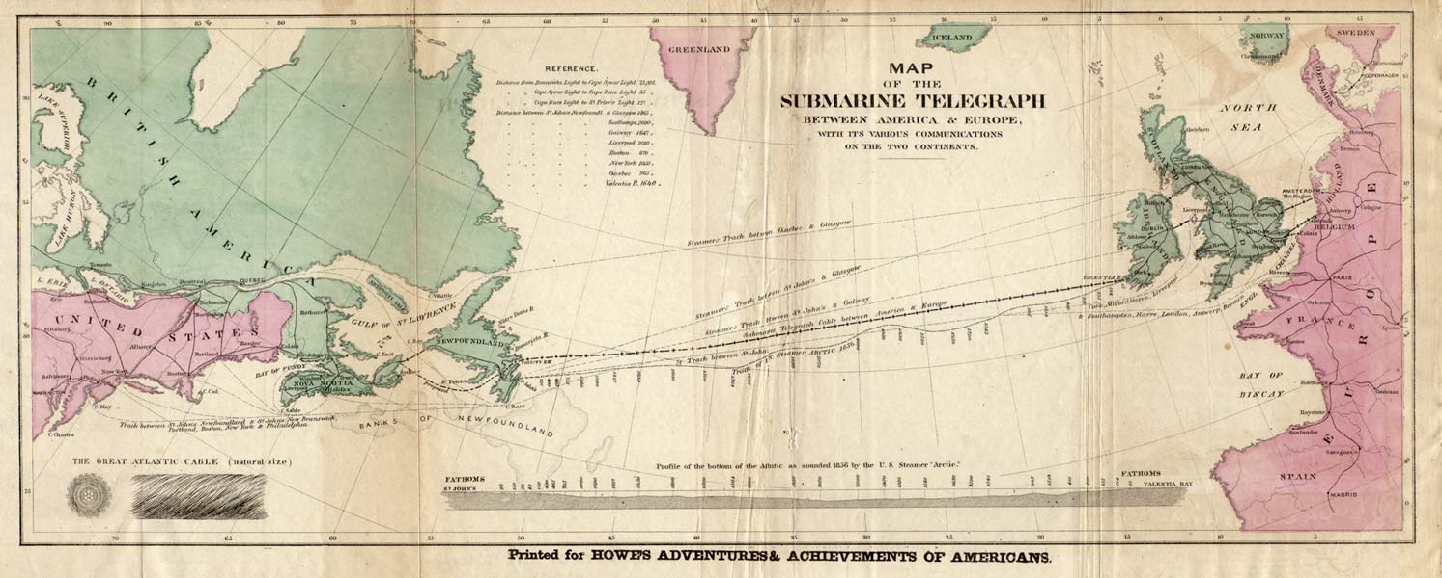
Cyrus W. Field’s
transatlantic cable
(1866)

Slide 15
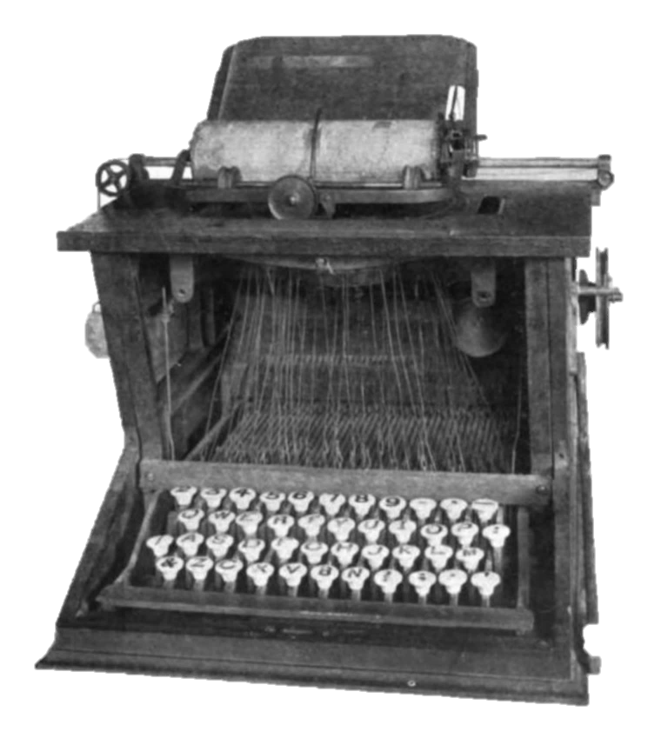
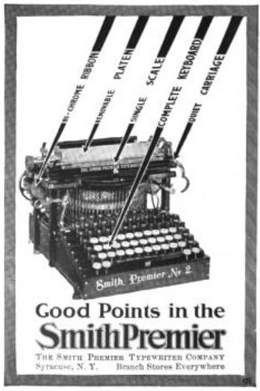
1867-Typewriter (group of people)
QWERTY keyboard

Slide 16
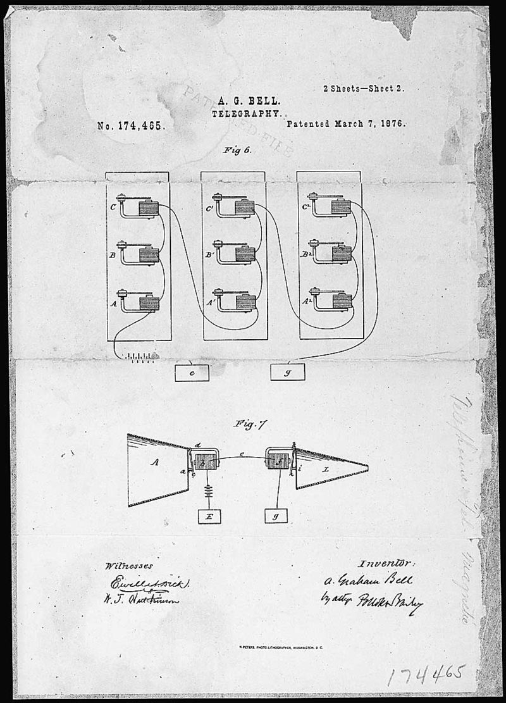
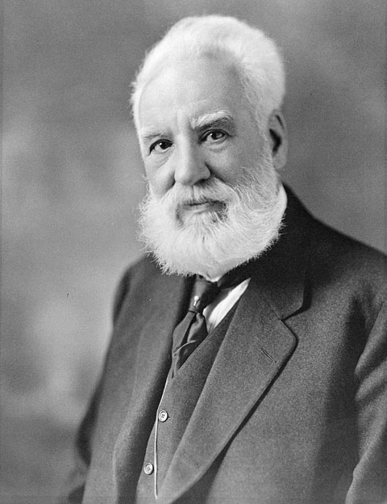
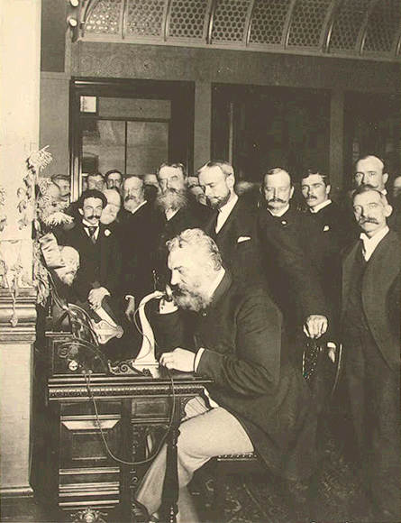
Alexander G. Bell’s telephone (1876)
Listen to the voice of Alexander Graham Bell

Slide 17
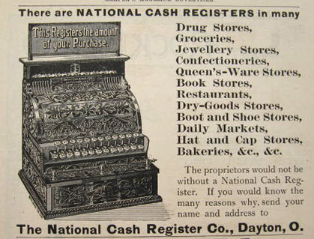
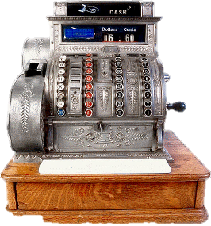
James Ritty’s cash register (1879)

Slide 18
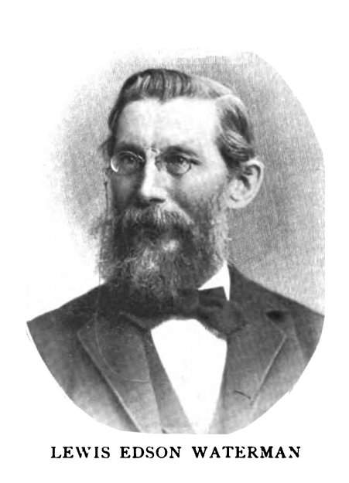
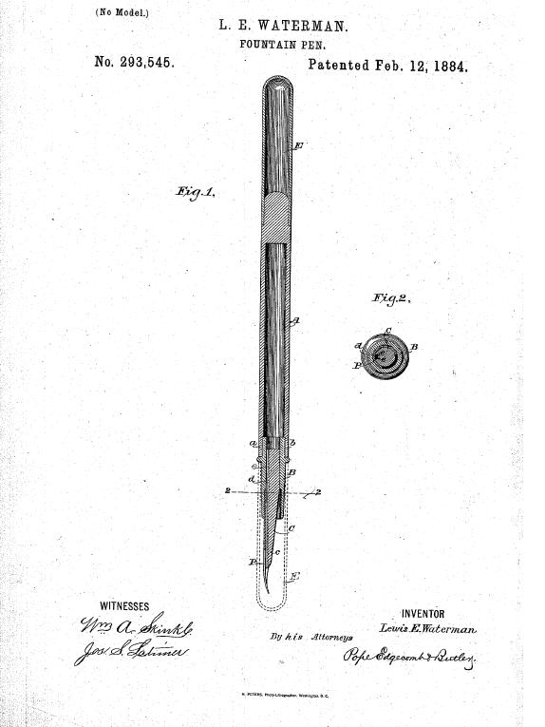
Lewis Waterman fountain pen (1884)

Slide 19
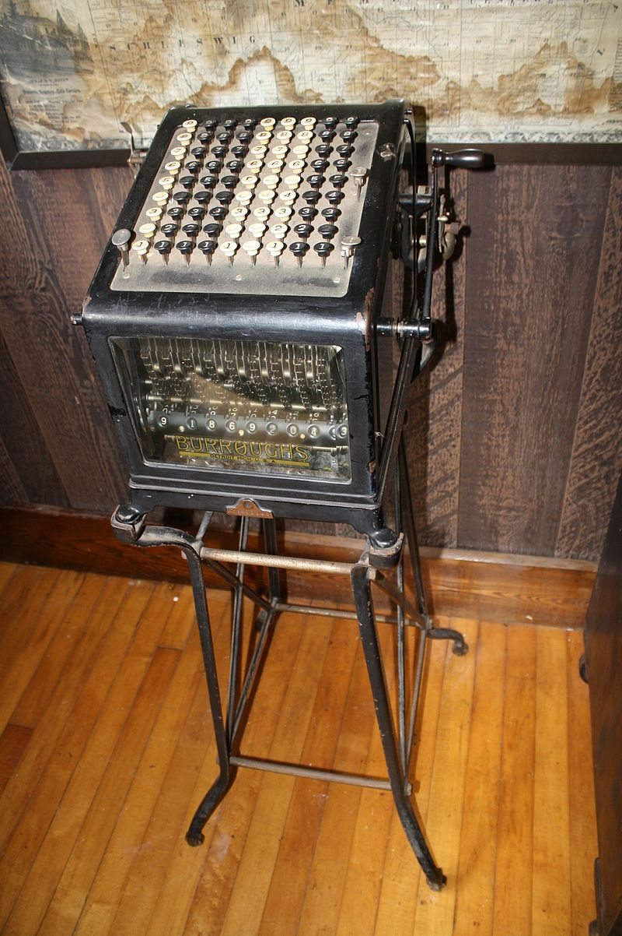
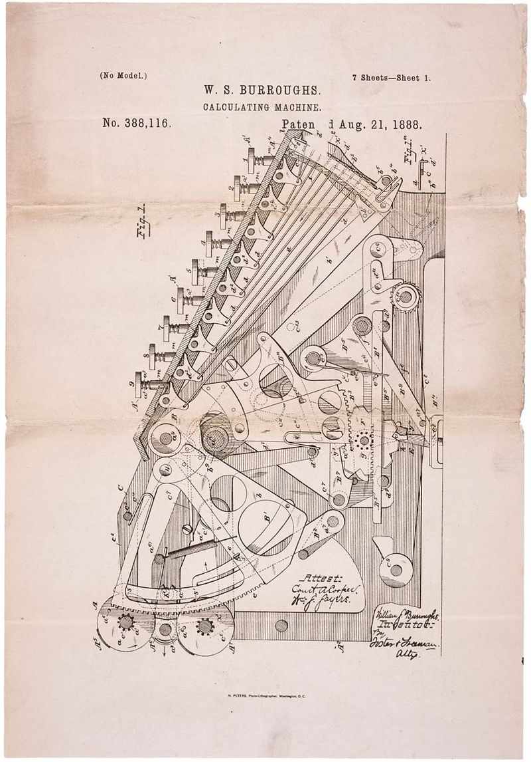
Calculating Machine (1887)
Adding Machine (1888)

Slide 20
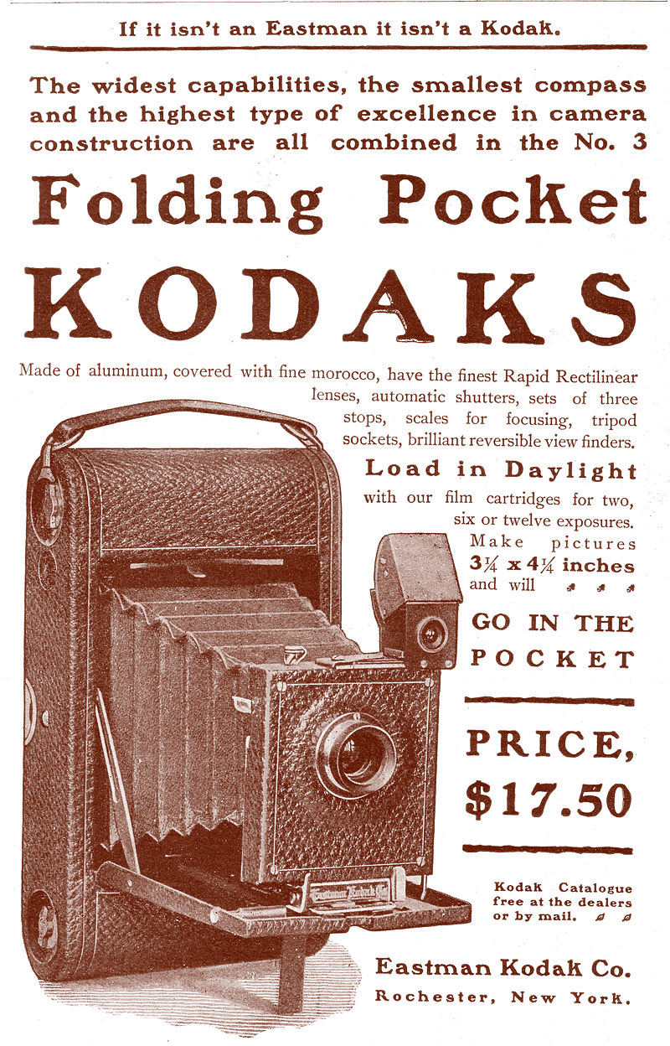
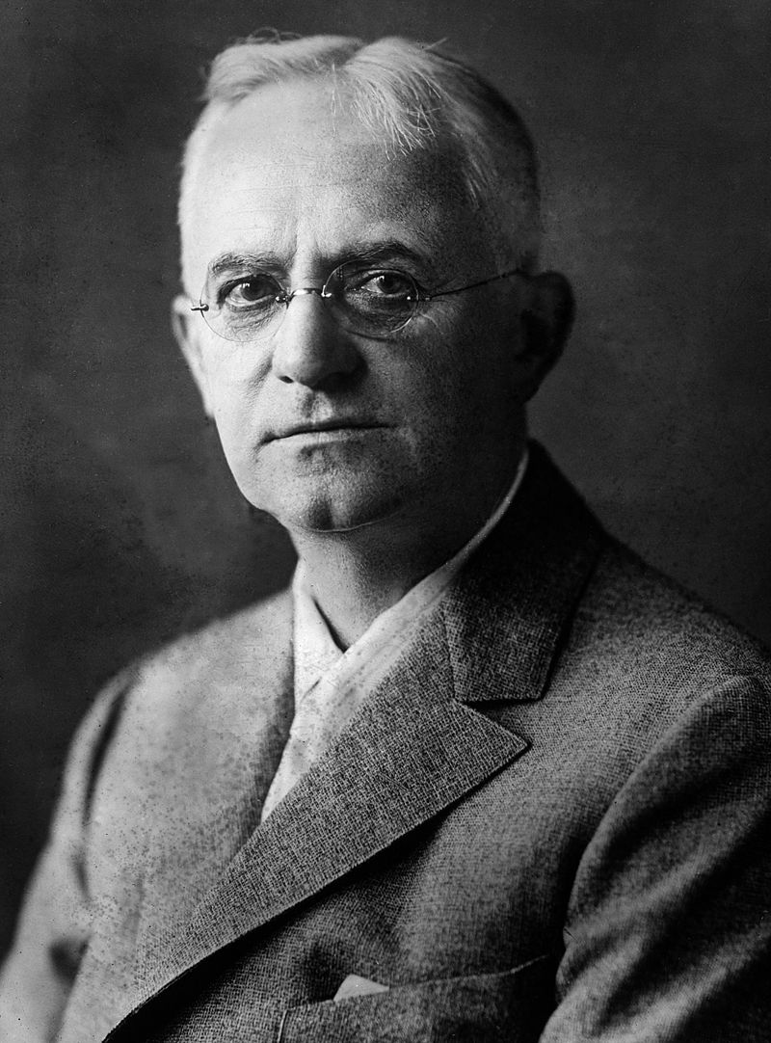
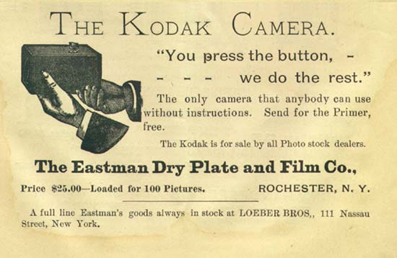
George Eastman’s Kodak camera (1888)
George Eastman Video

Slide 21
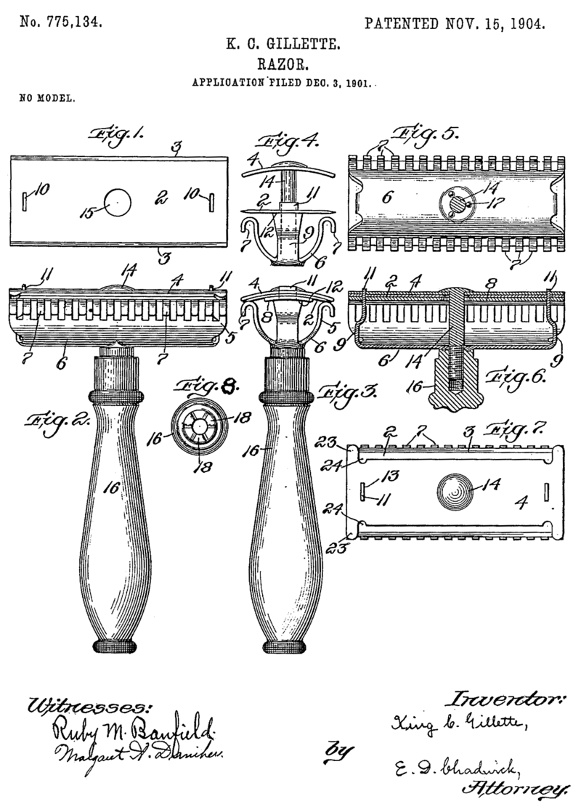
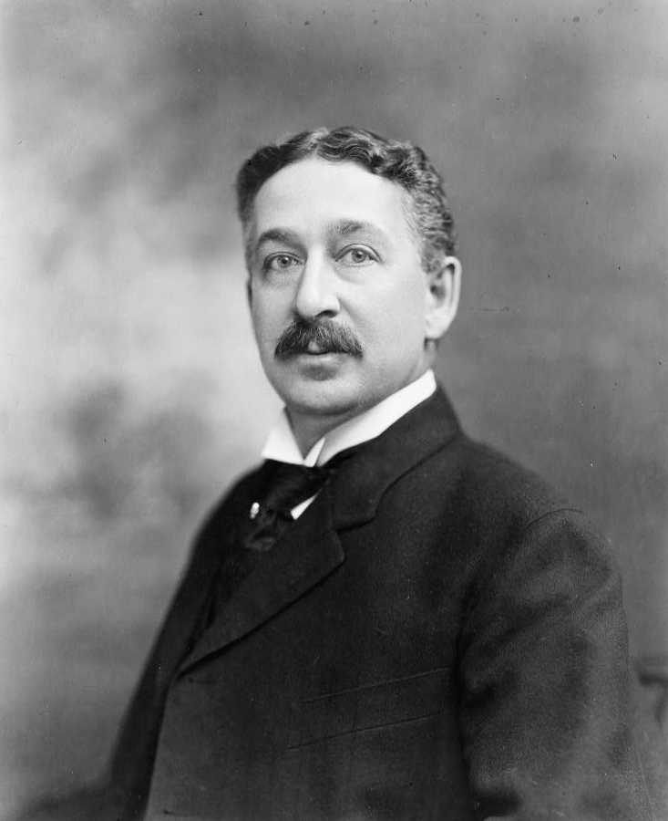
King Gillette’s safety razor (1895)
History of Gillette Video
1956 Gillette Commercial

Slide 22
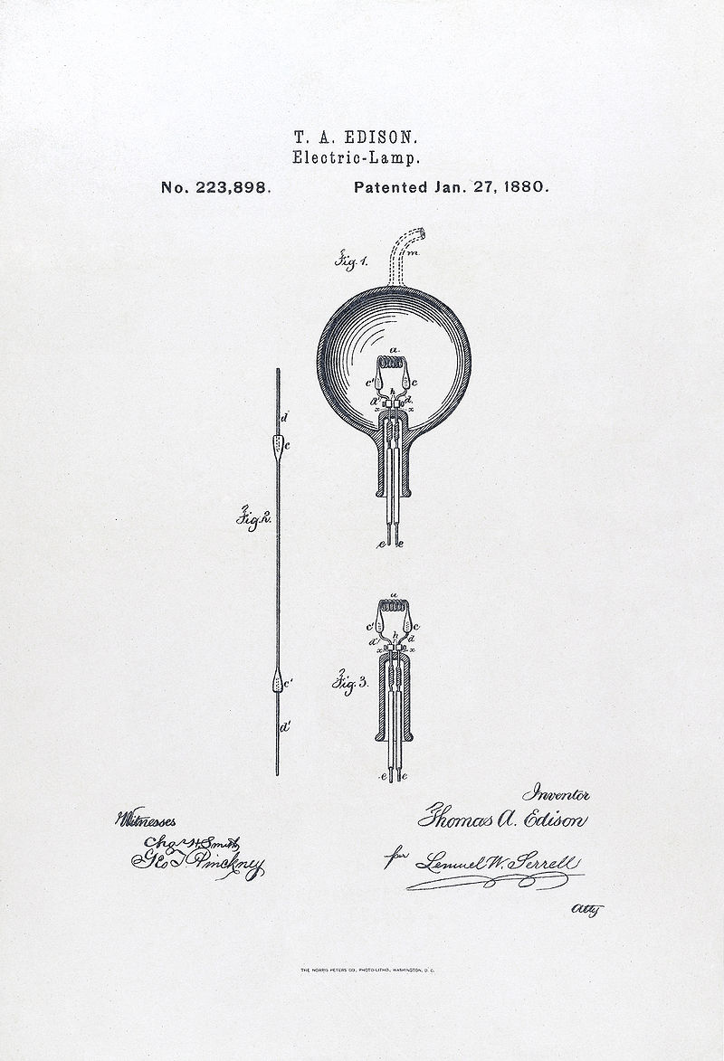
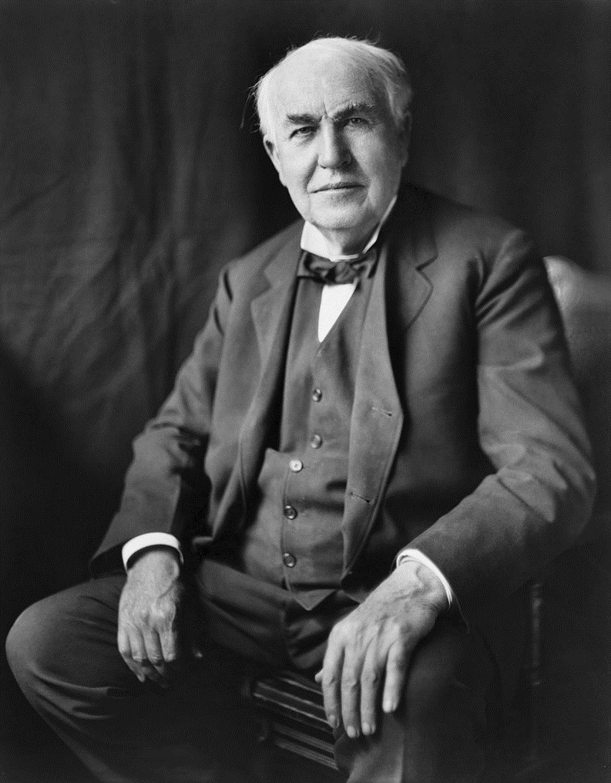
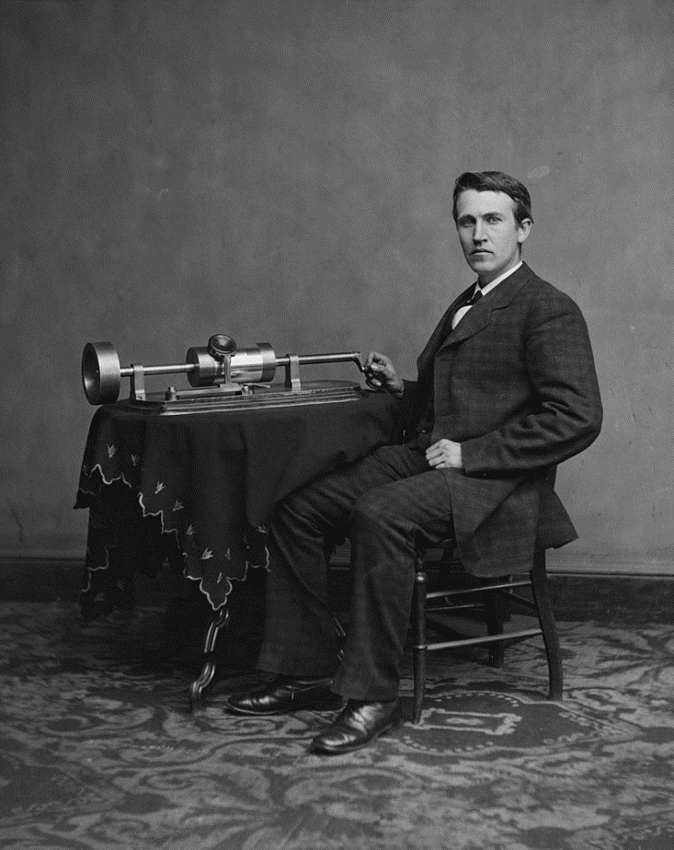
Thomas A. Edison
Menlo Park, NJ—over 1000 patented inventions including phonograph, incandescent lamp (light bulb), electric power generation and distribution (direct current), mimeograph machine, motion picture camera
History Channel Edison Video
1894 Boxing Match Video Recording
A day with Thomas Edison Primary Source Video
With phonograph

Slide 23
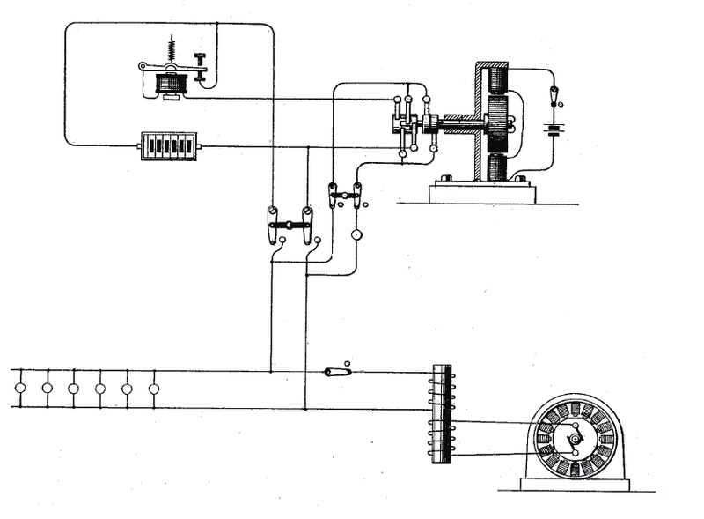
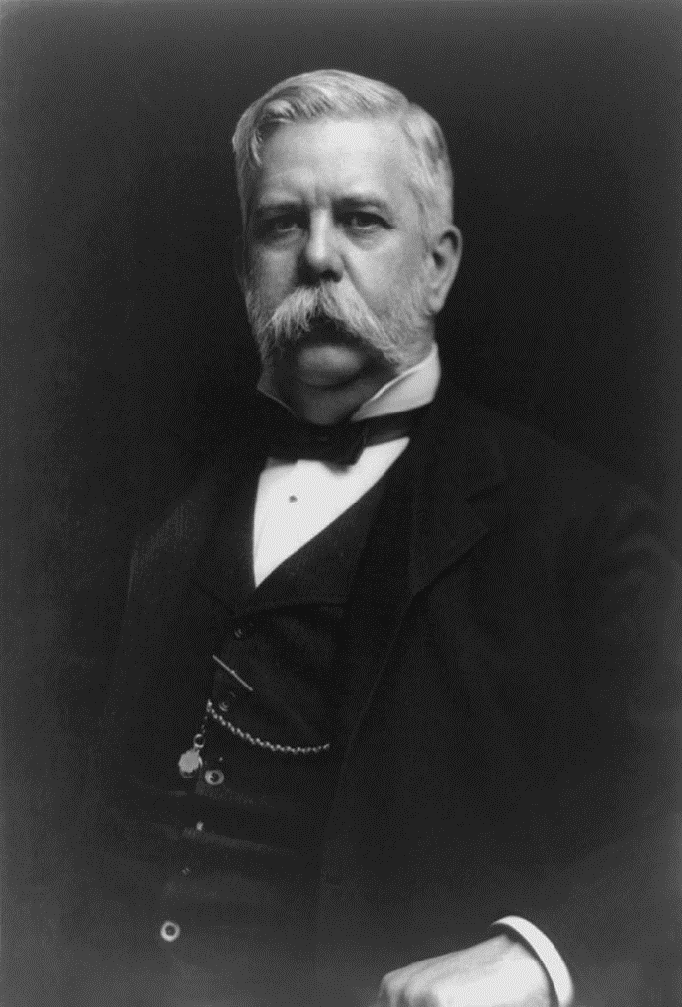
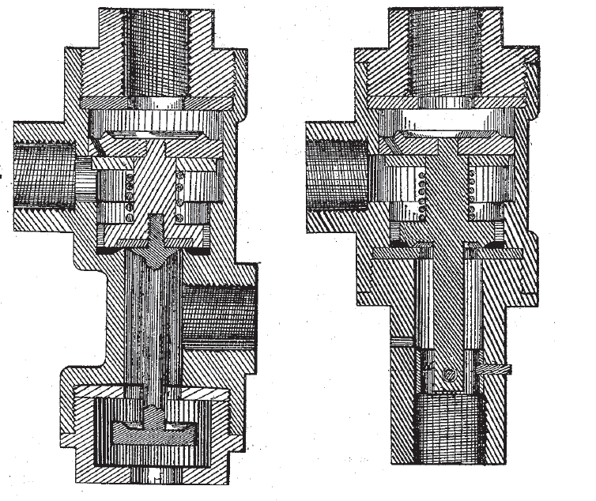
George Westinghouse
- over 400 patents—airbrakes for RR, transformer for producing high voltage alternating electric current (made lighting of cities, operation of electric streetcars and machines possible)
Steam and Airbrakes
AC Lighting System with Battery Backup Patent

Slide 24
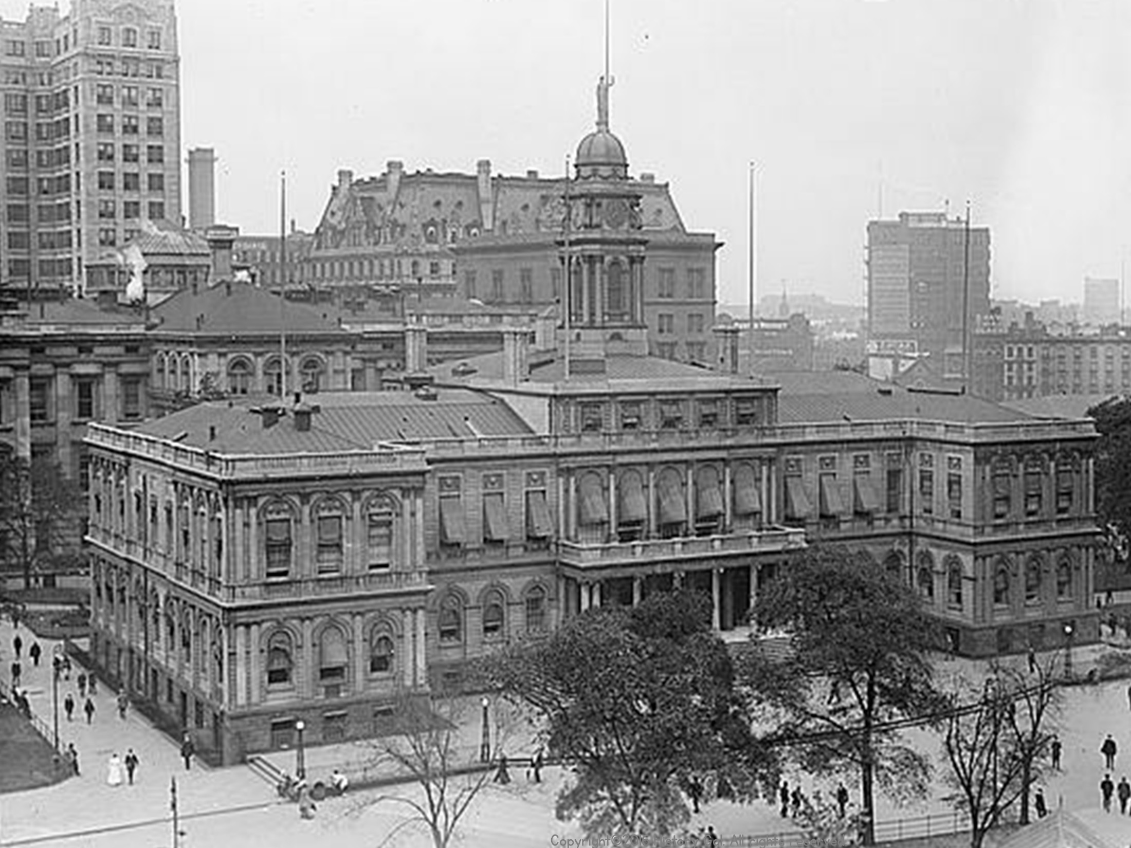
IMPACT OF INDUSTRIALIZATION
1890—10% of US population controlled 90% of the wealth
New Wealthy-flaunted their wealth (example is Vanderbilt’s Biltmore House)
Horatio Alger - author of popular novels in which a poor man became rich through working hard
Mostly a myth, very few people went from poor to millionaire
Upward mobility (moving to higher economic bracket) was possible
Expanding Middle Class
Copyright©2016 History Gal. All rights reserved.

Slide 25
WAGE EARNERS
1900—2/3s of American worked for wages (10 hours/day, 6 days/week)
Low wages because there were more workers than jobs
11 million families averaged less than $380/year
1/5 women worked, most were young and single, in industries that were extensions of the home (textile, food processing)
As demand for clerical workers increased women became secretaries, book keepers, typists and telephone operators
Crash Course Video: The Industrial Revolution
Copyright©2016 History Gal. All rights reserved.

